Slide 1
IHS 1200
Faculty Panel
Overview of Programs in Communication Sciences and Disorders

Slide 2
Introductions
Joann Benigno, Director of Communication Sciences and Disorders
Cheryl Prusinski, Coordinator of Professional Deaf Resources Liaison Certificate
Youngsun Kim, Coordinator of Master’s program in Speech-Language Pathology
Nilesh Washnik, Coordinator of Clinical Doctorate program in Audiology

Slide 3
Undergraduate Program

Slide 4

What is "Communication Sciences & Disorders" (BSCSD)?
Communication Sciences & Disorders (CSD) is an undergraduate major within the School of Rehabilitation and Communication Sciences.
Hearing, Speech and Language Sciences effective fall 2023.
Curriculum includes interdisciplinary coursework providing education of human communication processes, development, hearing, speech and language sciences.
We also offer a minor!

Slide 5
What courses will I take?
General Courses Include:
Biology
Statistics
Physics OR Chemistry
Intro to Special Education
Child Development
Anthropology
Public Speaking
Psychology
…..and more!
CSD Related Courses Include:
Intro to Communication Differences and Disorders
Phonetics
American Sign Language
Anatomy & Physiology of Hearing, Speech and Language
Speech Science
Hearing Science
Language Development
Intro to Research in CSD
…..and more!

Slide 6
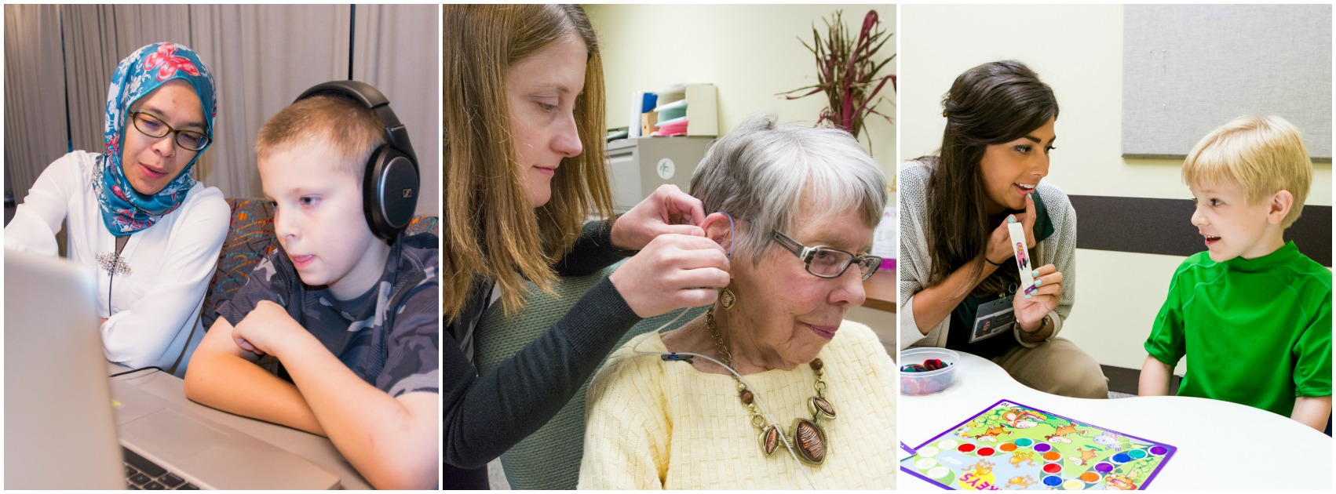
What can I do after graduation?
The typical route for CSD undergraduates is to go to graduate school for either speech language pathology or audiology. However, some graduates have chosen other paths such as research, education, and much more!

Slide 7
Can I study a minor with my CSD major?
Yes! In fact, the CSD program has leniency within the curriculum so a minor or certificate is easily accomplishable and sometimes even satisfy some CSD requirements. Some common minors and certificates within CSD include...
Psychology
Gerontology
Community and Public Health
Communications
Professional Deaf Resources Liaison
Business
Linguistics

Slide 8

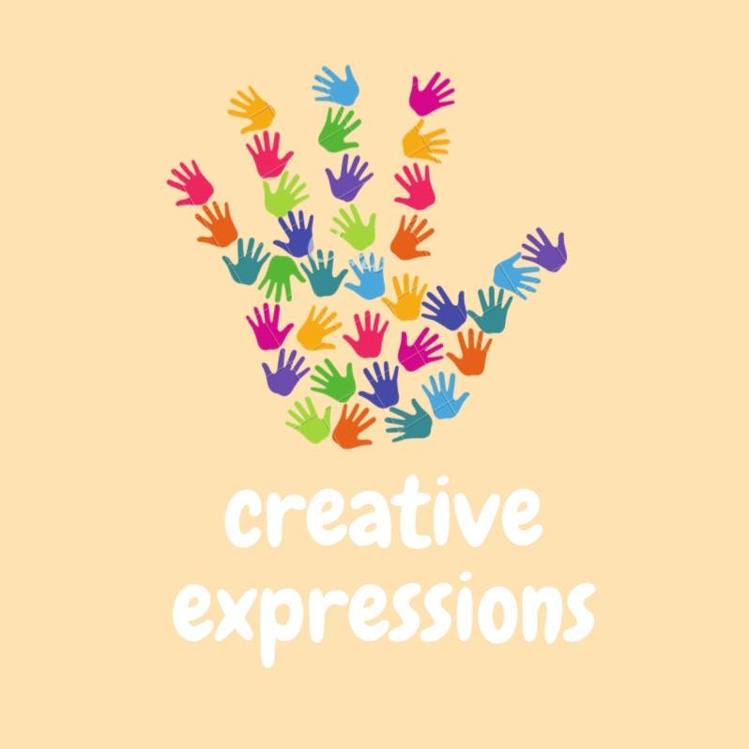

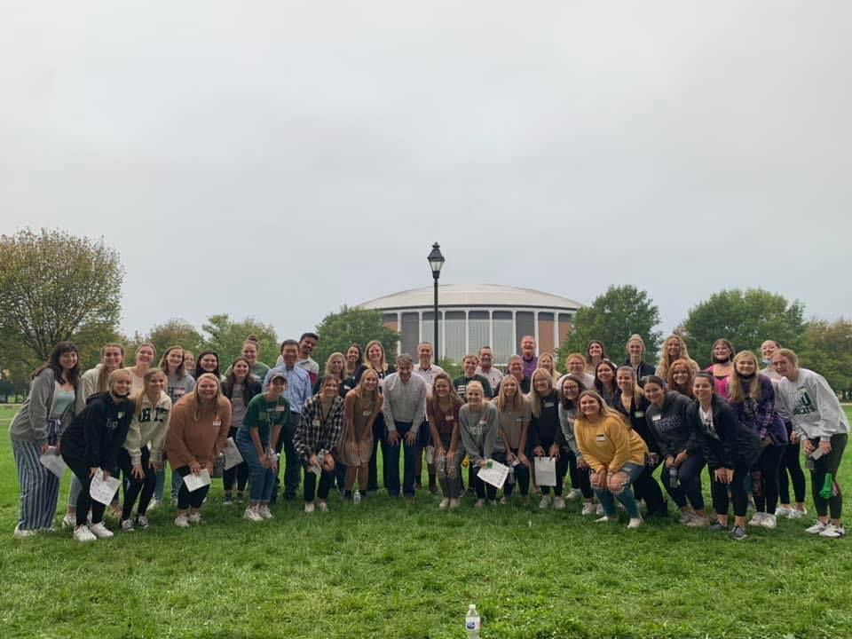
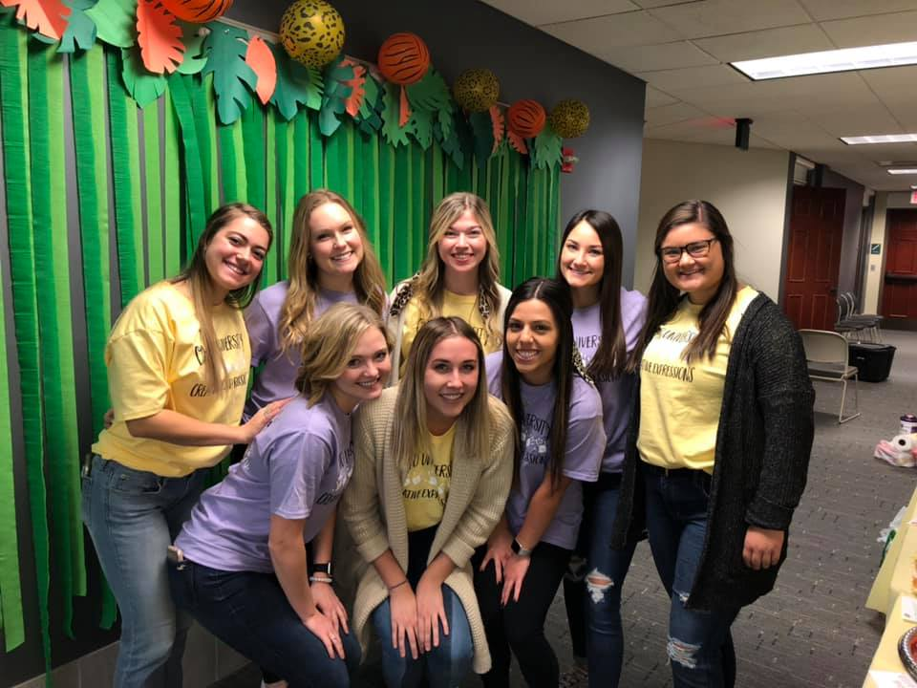
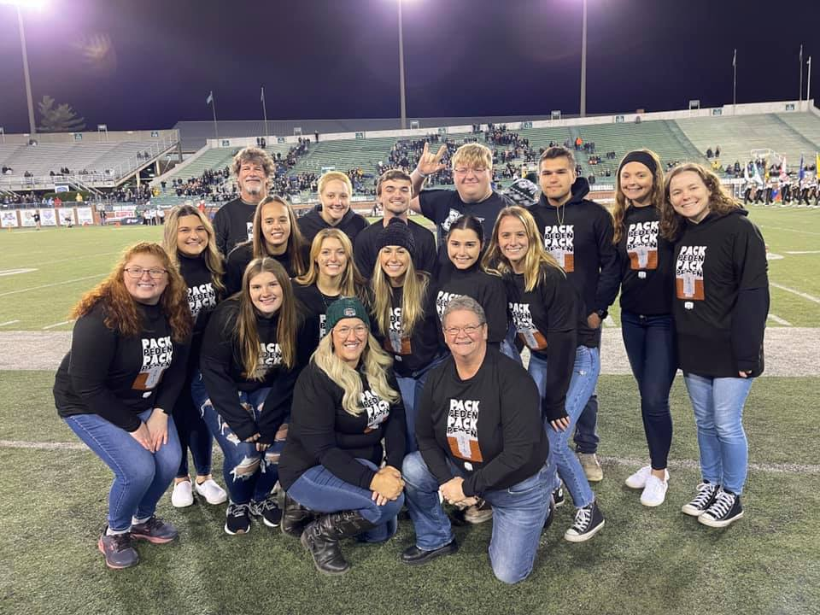
How can I get involved?
Ohio University has a club for every person and every hobby! Some CSD related organizations include...

Slide 9
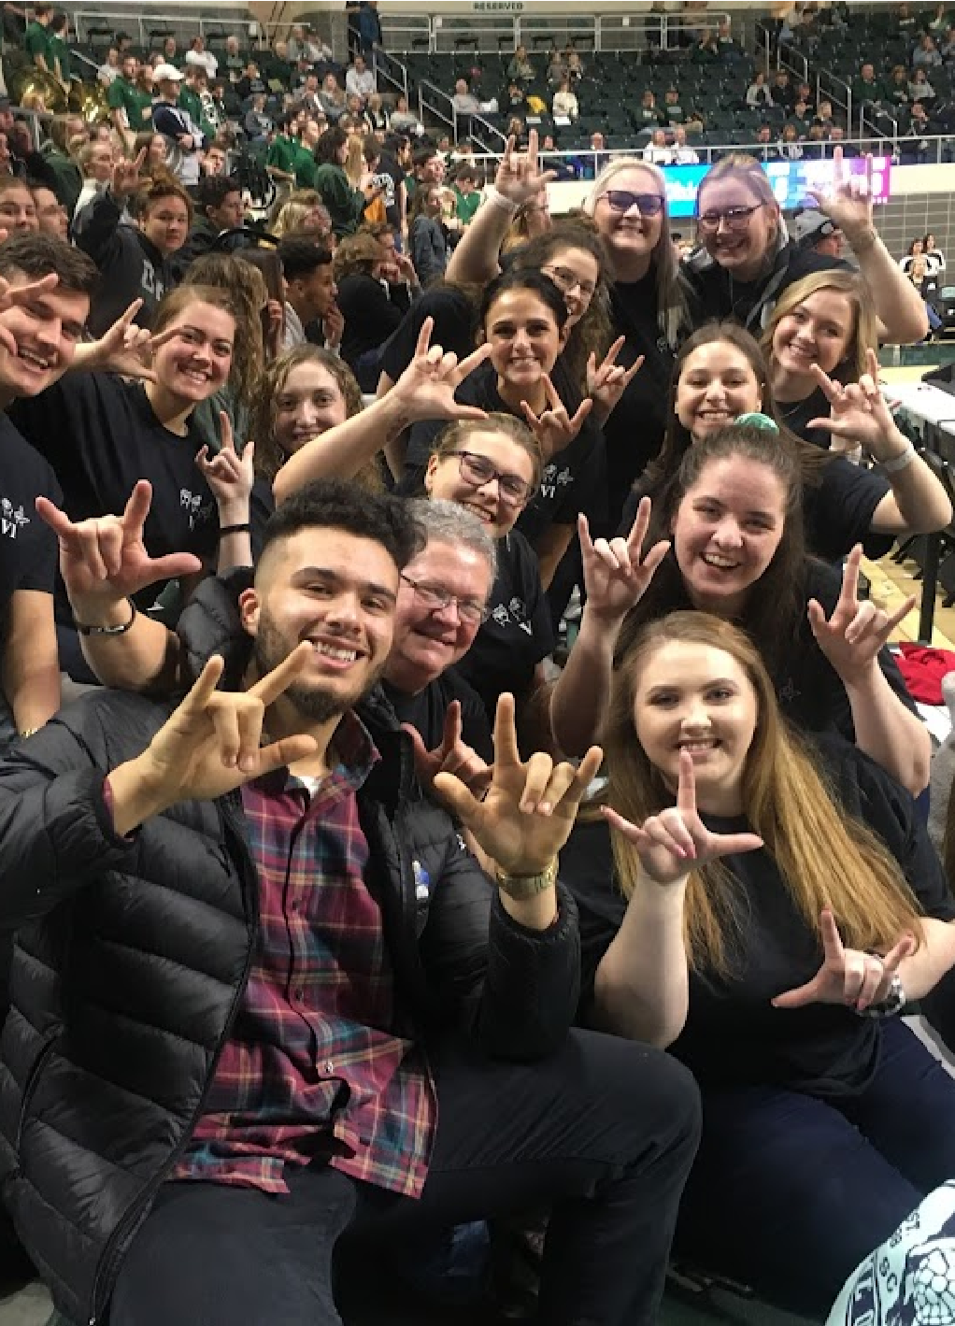
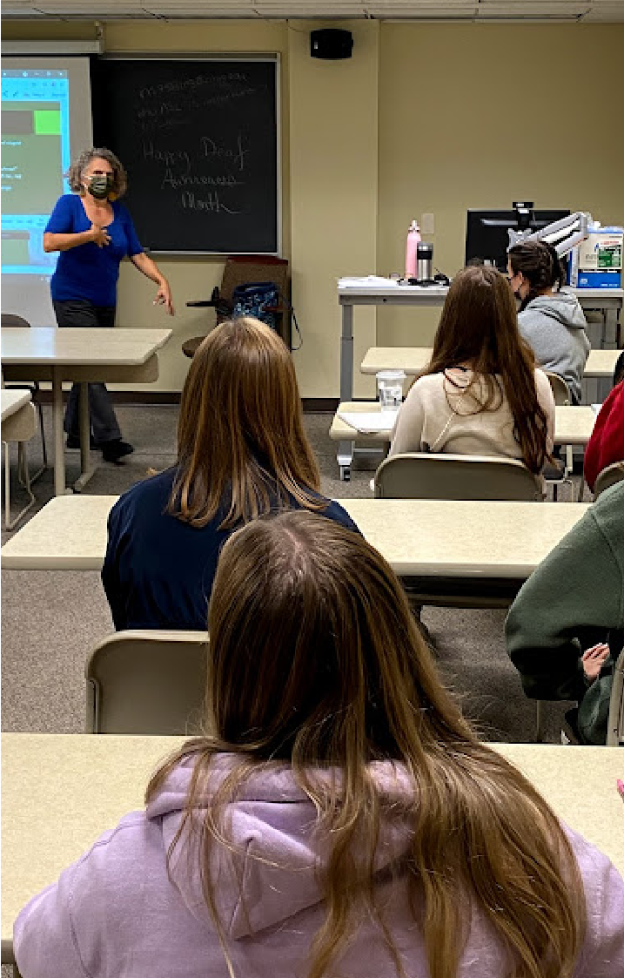
Deaf Professional Resources Liaison Certificate
Cheryl Prusinski, MA

Slide 10
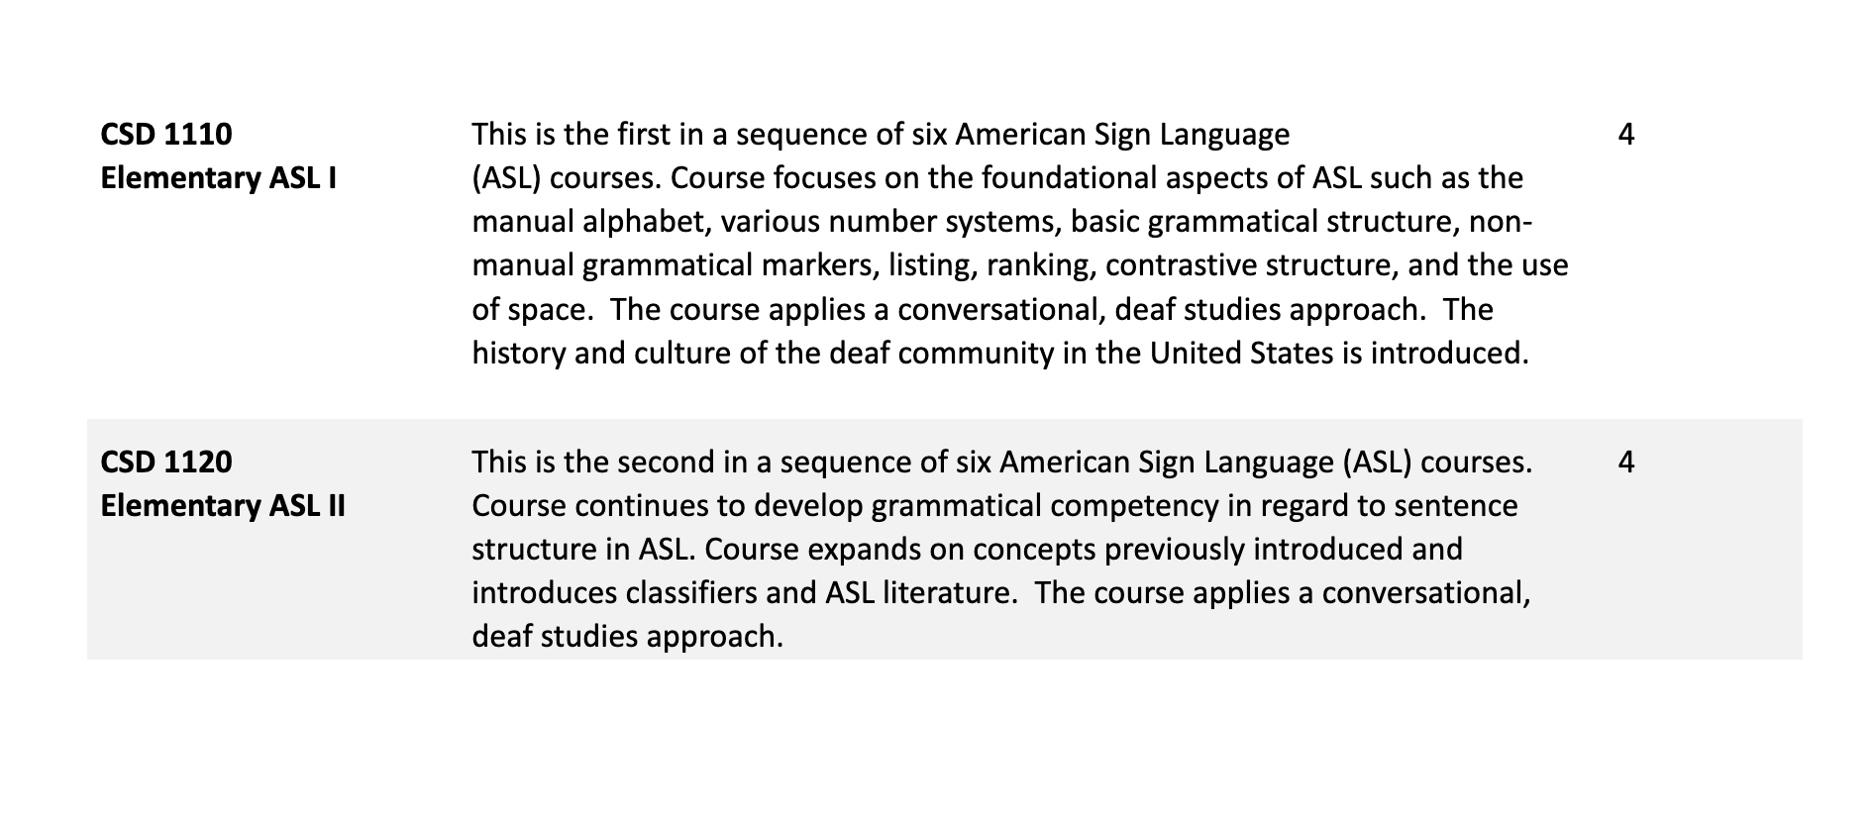
Certificate Pre-Requisite Courses:

Slide 11
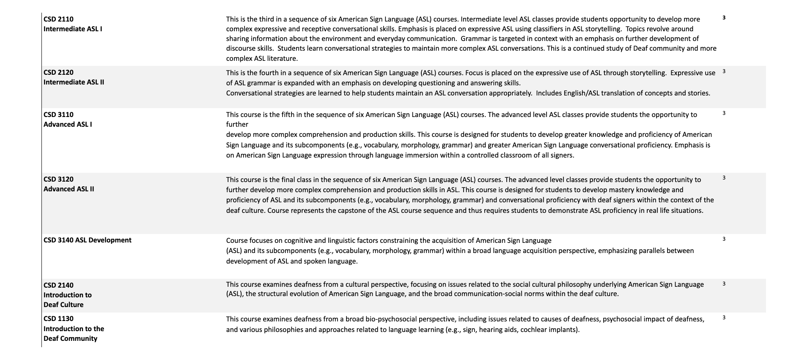
Certificate Required Core Courses

Slide 12
Certificate Outside Options
EDCS 1011 Intro to Diversity Studies -or- ANTH 1010 Intro to Cultural Anth. | Introduces concepts important to understanding diversity, especially in the United States. Concepts such as privilege, domination, deculturalization, socialization, intersectionality, marginalization and others are explored. Provides an introductory exploration in the domains of race/ethnicity, gender, class, sexual orientation and disability Students learn about the core concepts used in cultural anthropology and how anthropologists’ study human cultures and societies. Consideration is given to the relevance of anthropological theories, methods, and ethics in the context of contemporary culture change, taking into account processes of colonialism, globalization, and development. Students gain an appreciation of the broader goals of cultural anthropology to record cultural patterns and behaviors, represent a variety of voices and perceptions, explain cultural processes, and develop a fundamental understanding of human diversity. | 3

Slide 13
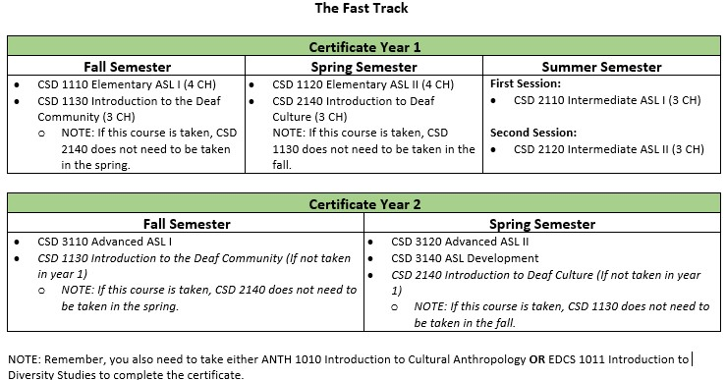
Certificate Fast Track

Slide 14
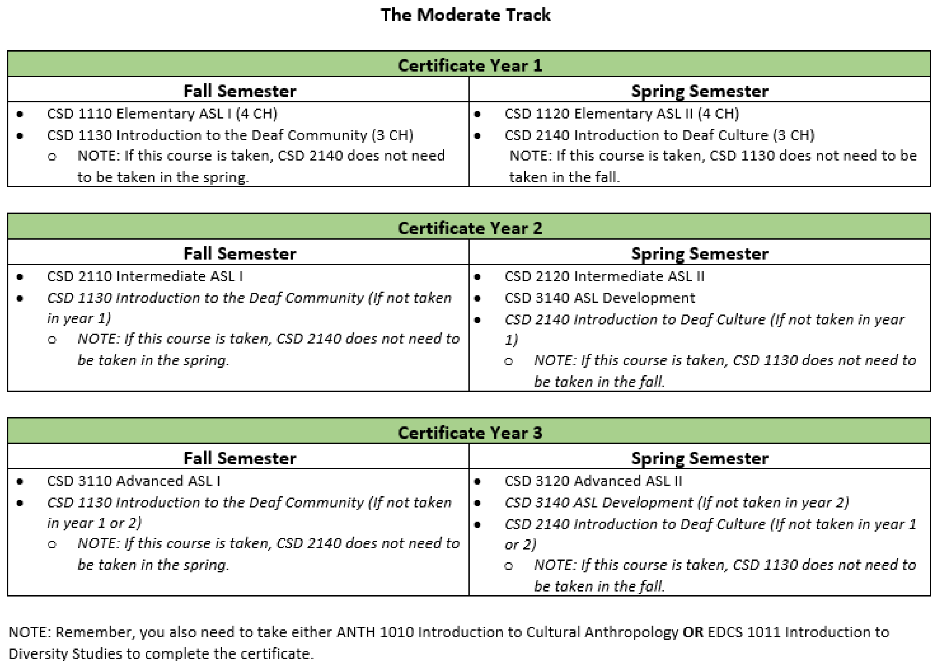
Certificate Moderate Track

Slide 15
Professional Programs
Careers in Speech-Language Pathology and Audiology

Slide 16
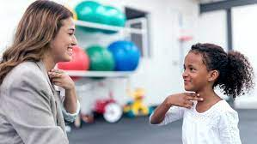
Speech-Language Pathologist (SLP)
Evaluate and provide prevention and remedial services to children and adults with speech, language, voice, and swallowing problems.
Scope of practice
  Speech (articulation, fluency, voice)
  Language (“grammatical” & effective)
Also included (you may not think of)
  Swallowing (Safely getting nutrition by mouth)
  Alternatives for people who cannot talk via speech
  Literacy
  Accent reduction/modification
  Research (lots of research opportunities)

Slide 17
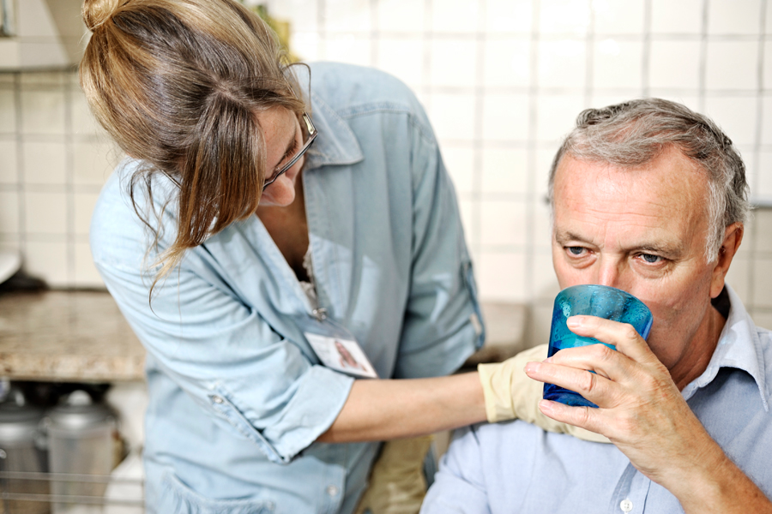
Speech-Language Pathologist (SLP)
Healthcare Facilities
(hospitals, clinics, private practices, physicians’ practices, rehabilitation centers, home health care agencies)
School Systems (~50% of SLPs)
Colleges/Universities
Government Agencies

Slide 18
Ohio University MA SLP program
Faculty specializing in:
  AAC
  Brain-based Communication Disorders (Dementia)
  Child Language
  Dysphagia
  Speech Processing
Joint MA/PhD Option
On-Campus Clinic
  Begin clinic fall semester Year 1 in our campus clinic
Full-Time Externships
  Spring and Summer of Year 2
  Opportunities across the U.S.
Rural Outreach
Teacher Licensure Option
Botswana Rehabilitation Program and Other IPE Opportunities
You can start the SLP journey by taking HSLS 1080 this fall!

Slide 19
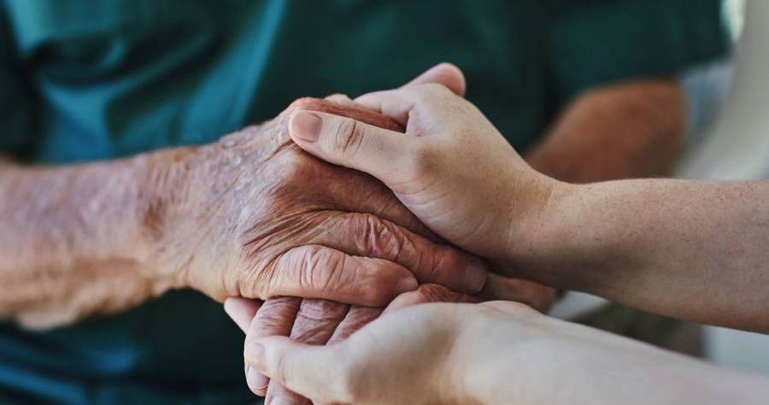
Audiology

Slide 20
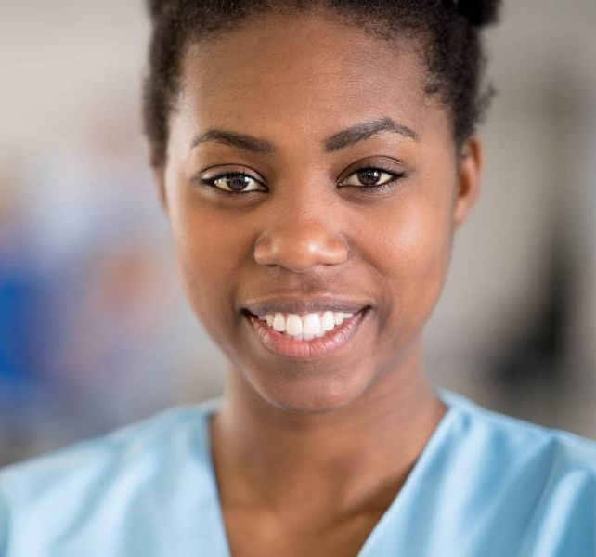
What DOES An AUDIOLOGIST do?
Audiologists work with patients of all ages from newborns to elderly who present with hearing and balance disorders.
Audiologists evaluate, diagnose, and treat a variety of hearing problems
They supervise & conduct new-born hearing screenings

Slide 21
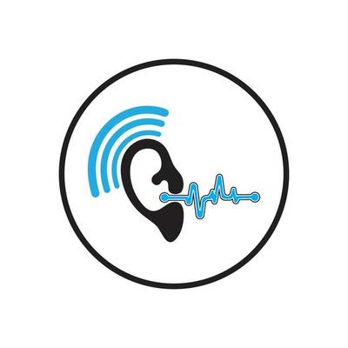
What DOES An AUDIOLOGIST do?
They assess the candidacy of persons with hearing loss for hearing aids and cochlear implants and provide fitting, programming, and audiologic rehabilitation to ensure the best possible outcomes.
They counsel and educate teachers, older adults, children and their families about hearing loss
Audiologists serve on multi-disciplinary teams with other professionals including physicians, physical therapists, optometrists, teachers, and speech-language pathologists and make medical referrals

Slide 22
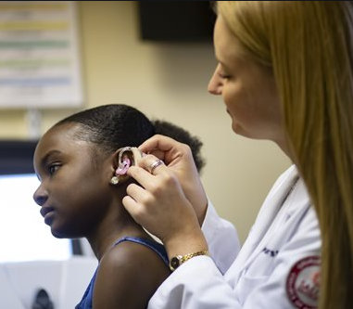
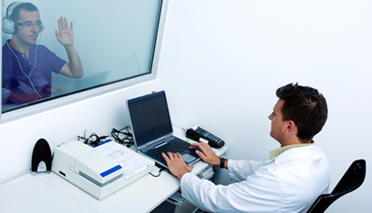
A Career as an Audiologist
Need a bachelor’s degree in Communication Disorders & Sciences or Speech & Hearing Science (or required set of undergraduate courses with a different undergraduate degree)
Then need clinical doctoral degree in Audiology (Au.D) from an ASHA CAA accredited audiology graduate program. You will be Dr. X.
Pass the National Audiology Praxis exam for licensure and certification.

Slide 23
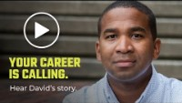
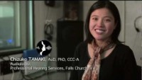
Hospitals
Doctors’ offices
Private and Group Practice
Long-Term Care Facilities
K-12 Schools
Other Schools and Programs for special-needs children
Colleges and Universities
Military (2.7 million veterans have service-connected hearing disabilities)
Local, State, and Federal Government Agencies
Industry
​
​
Where do AUDIOLOGISTS WORK?

Slide 24
What’s the Job Outlook? Will there be jobs?
Audiology job opportunities growing 13% between 2019 and 2029 (Bureau Labor Statistics)- faster than average GROWING profession
High Employment- you can find a job! Often multiple job offers

Slide 25
5 reasons to be an AUDIOLOGIST
LOVE GOING TO WORK EVERY DAY to HELP people with hearing and balance issues make a difference in their lives.
Flexibility – choose a job in a variety of settings and (hospitals, clinics, doctors office, school etc) can work with a small or wide age range of clients.
Never get burned out- if you are tired of one setting/population or age group, CHANGE jobs. Jobs are available and will be in the future with growth anticipated. Opportunities in administration.
Often part of a TEAM in health care or school setting, but usually have a lot of autonomy and independence too.
  5) Good salary

Slide 26
Ohio University AuD Program
Faculty specializing in:
  Cochlear Implants
  Auditory Electrophysiology
  Noise Exposure and Hearing Conservation
  Vestibular Assessment and Rehabilitation
Joint AuD/PhD Option
On-Campus Clinic
  Begin clinic fall semester Year 1 in our campus clinic
Full-Time Externships
Botswana Rehabilitation Program and Other IPE Opportunities

Slide 27

Thank you
Nilesh Washnik
740-593-1408​
washnik@ohio.edu

Slide 28
Questions?

