Slide 1
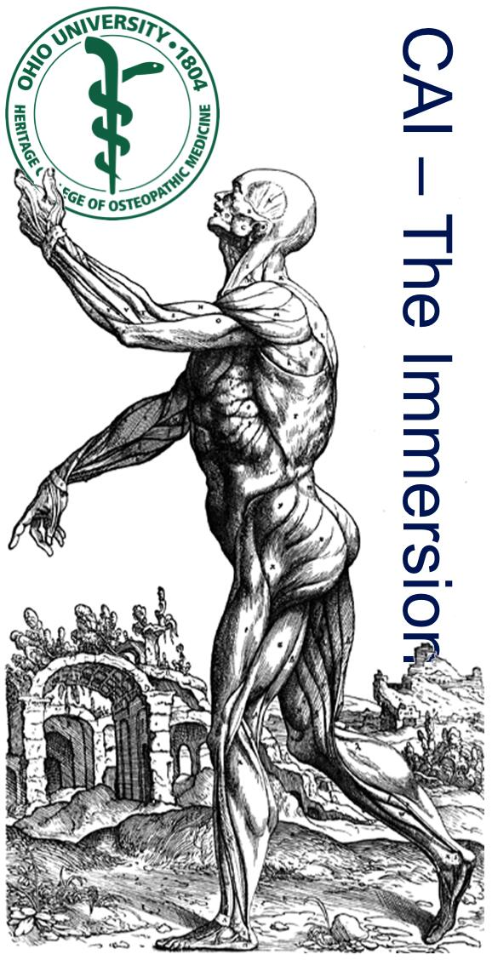
Introduction to the
Clinical Anatomy Immersion
24 July 2017
Lawrence M. Witmer, PhD
Professor of Anatomy
Dept of Biomedical Sciences
Heritage College of Osteopathic Medicine, Ohio University
Athens, Ohio 45701
witmerL@ohio.edu
from Vesalius, De Humani Corporis Fabrica (1543)

Slide 2
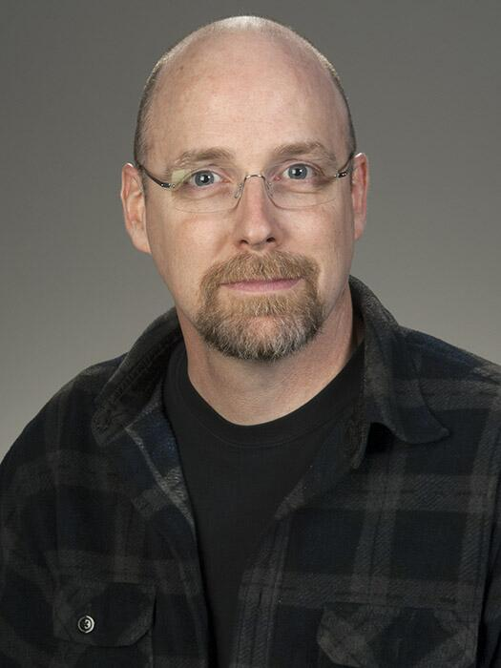
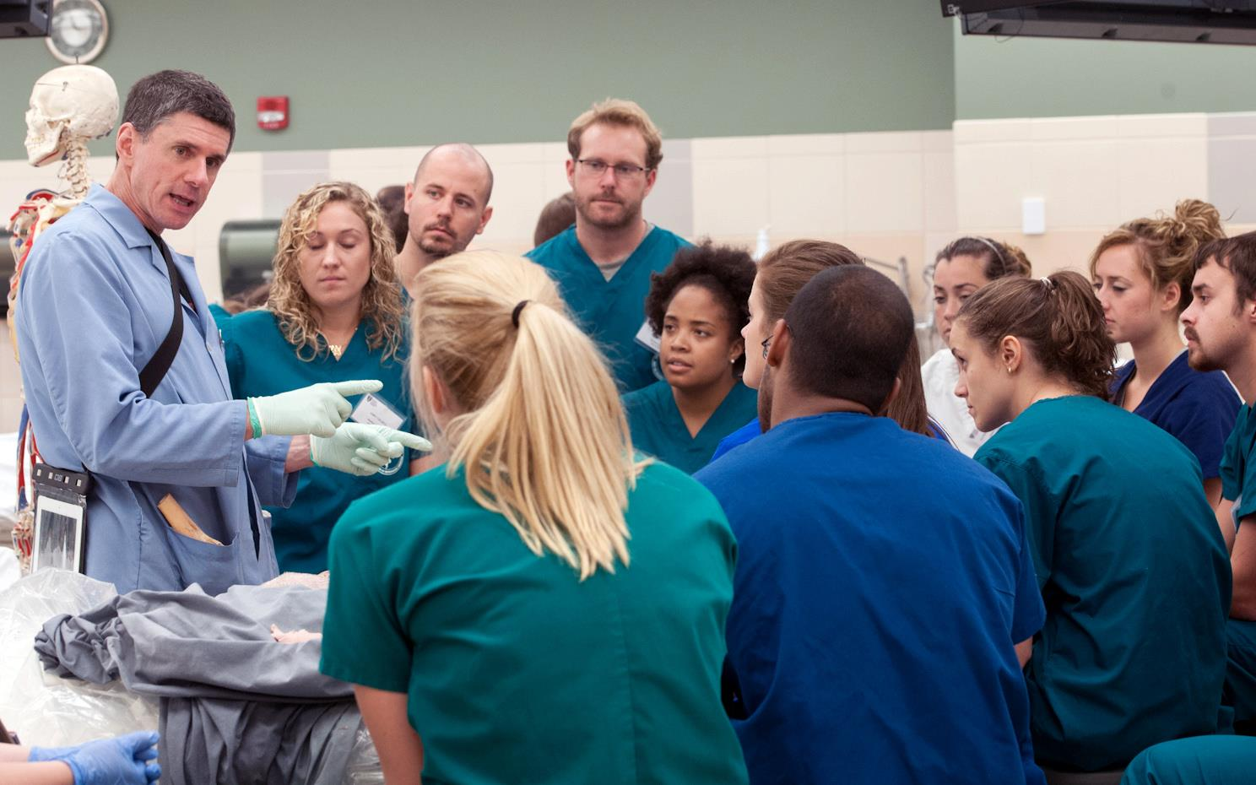
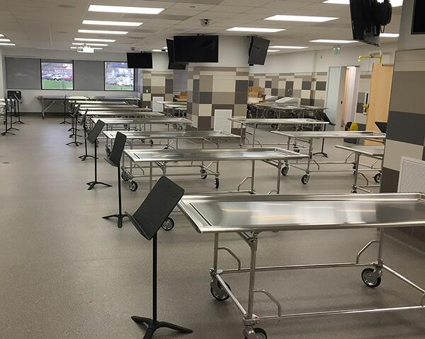
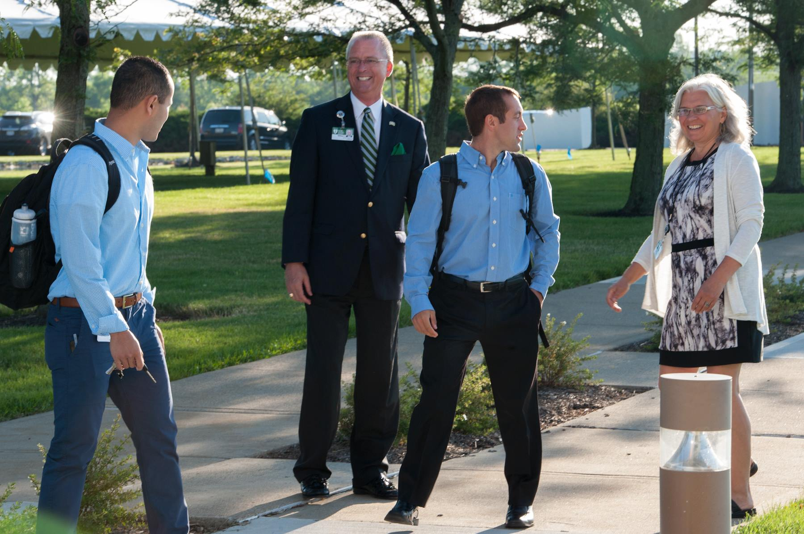
HCOM – Athens
HCOM – Cleveland
One College
•~~~•
Three Campuses
HCOM – Dublin

Slide 3
Features of the Immersion
• “Immersion”—highly focused, few other activities
• Four days per week (Mon-Tues-Thurs-Fri)
• Three hours of lab per day, balance of time is largely for reading and other preparation
• OMM is the other major player in the Immersion
• Frontloads musculoskeletal anatomy (back & limbs)
• Has a strong clinical emphasis

Slide 4
Justification for the Immersion
• Gross anatomy is the foundation and language of medicine—particularly Osteopathic Manipulative Medicine (OMM)
• Provide that foundation prior to beginning the rest of your training
• Quickly bring all students up to the same level
• Better prepare all our students for OMM training
• Provide a clinical focus & orientation at the outset
• Starting the process of clinical thinking & problem solving

Slide 5
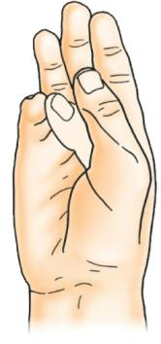
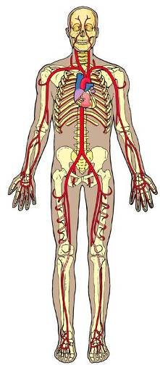
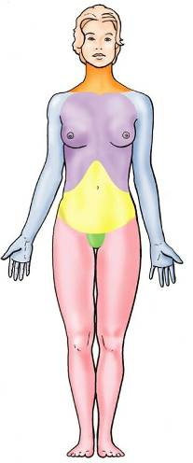
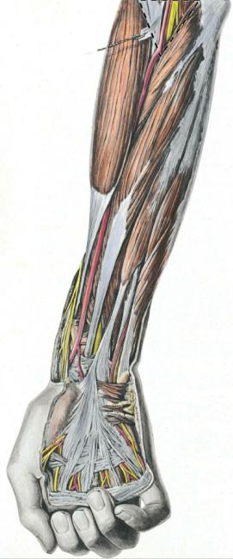
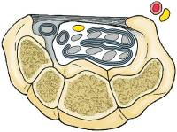
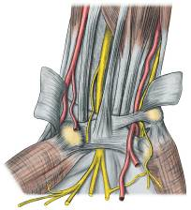
What Is Clinical Anatomy?
Systemic
Anatomy
Regional
Anatomy
Clinical
Anatomy
head &
neck
Carpal tunnel syndrome
• paresthesia
• thenar wasting
• hand weakness
arterial
system
thorax
upper
limb
abdomen
& pelvis
median
nerve
lower
limb
(from M&D COA6 2010)

Slide 6
Why Emphasize Clinical Anatomy?
• Medical school is for training physicians, not anatomists
• Promotes critical thinking and clinical problem- solving using anatomical knowledge
• Enhances ability to learn and retain anatomy
• Retention is better if learning is done in the context in which it will be ultimately used
• “Seeing the forest [clinical application] for the trees [anatomical structures]”
• “Reciprocal illumination”
• Need anatomy to understand clinical practice
• Need clinical correlations to understand anatomy

Slide 7
Why Emphasize Clinical Anatomy?
A.T. Still’s Four Tenets of Osteopathic Medicine
1. The body is a unit; the person is a unit of mind and body
2. The body is capable of self-regulation, self- healing, and health maintenance
3. Structure and function are reciprocally interrelated
4. Rational treatment is based on the above three principles
Anatomical structure is at the core

Slide 8
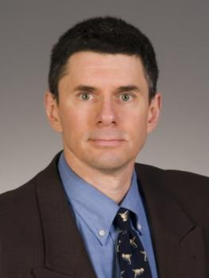
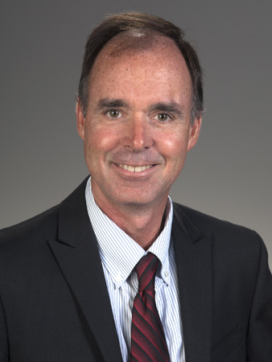
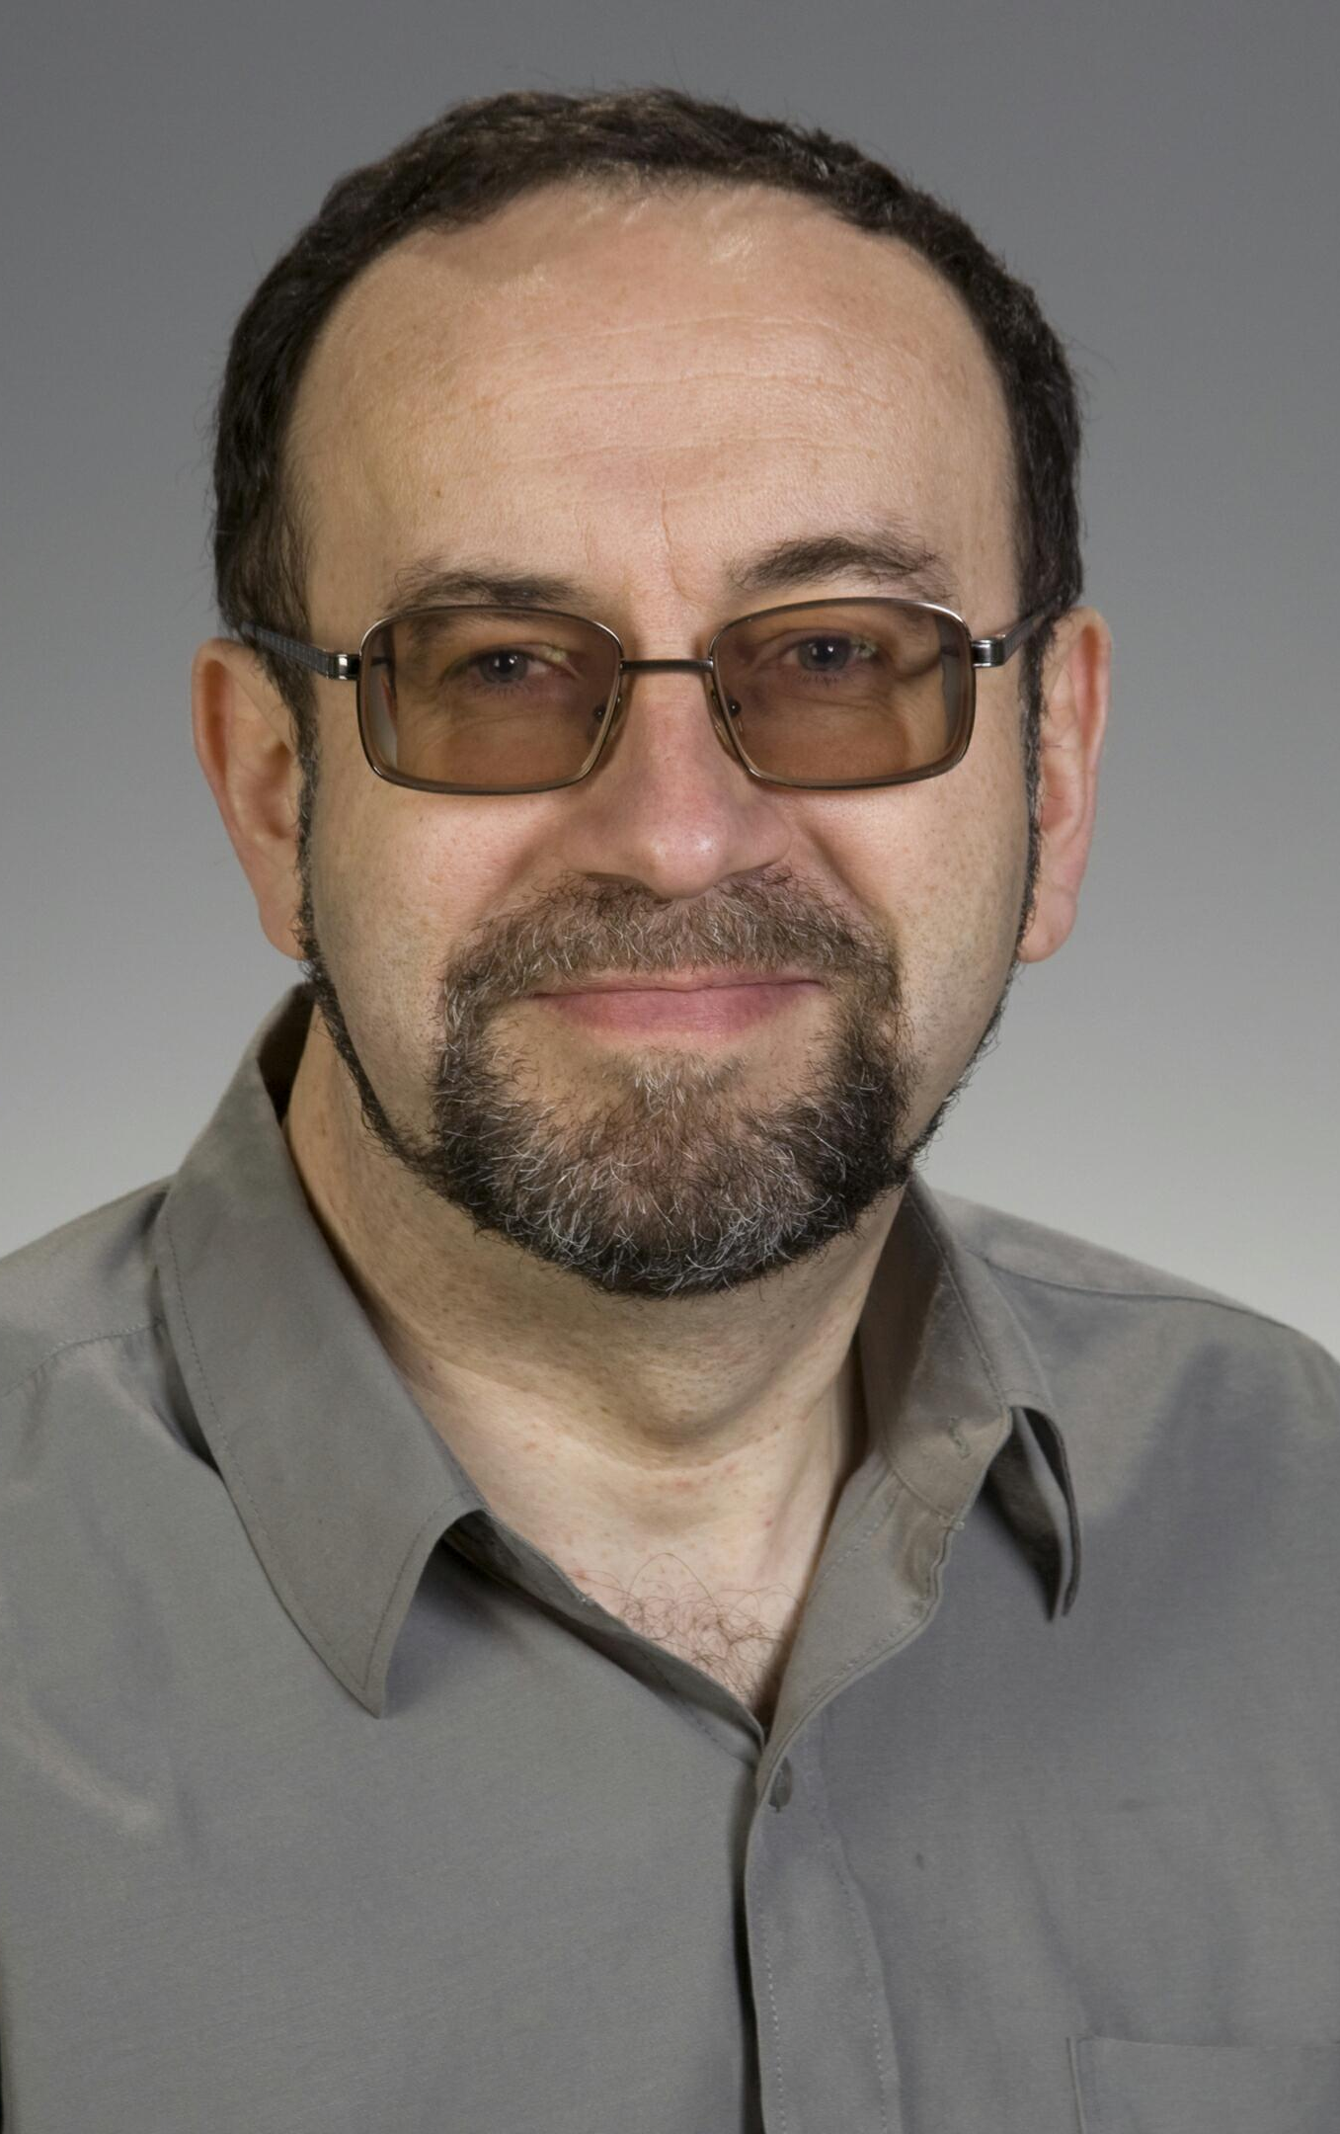
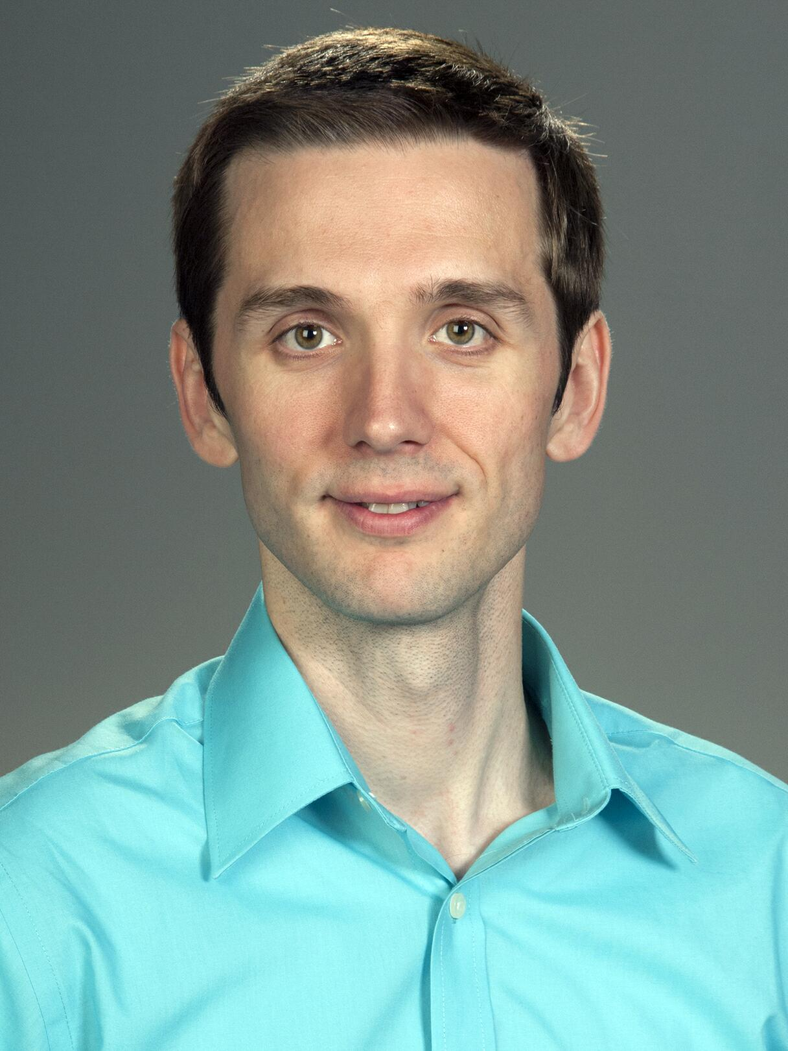
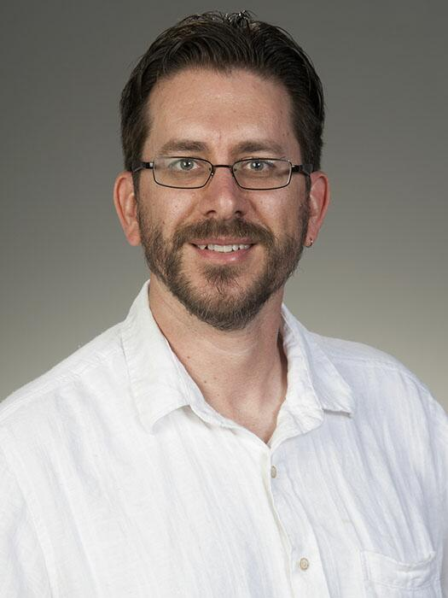
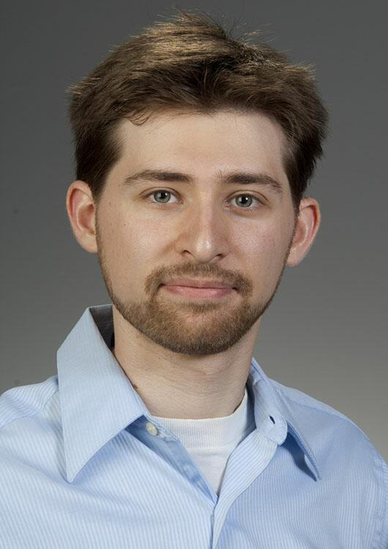
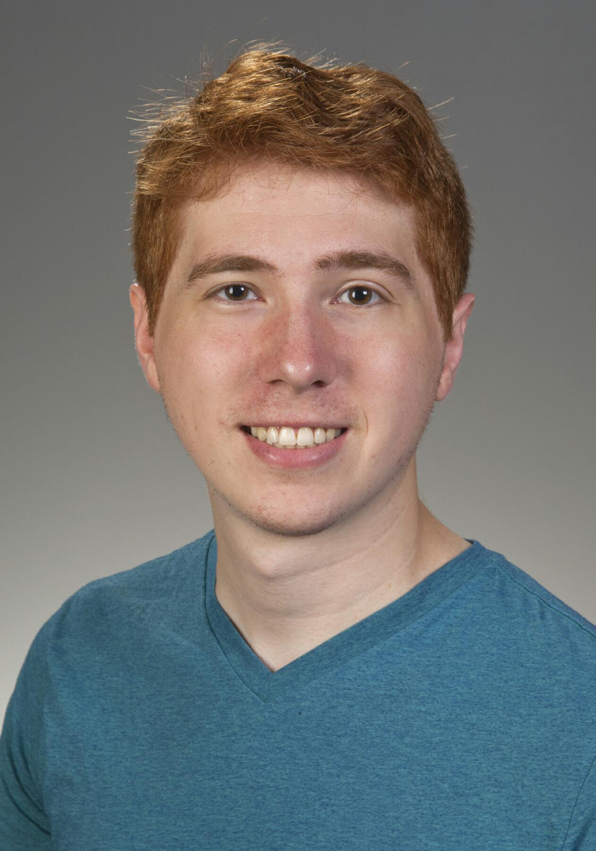
Anatomy of the Immersion: staff
L. Witmer, PhD
Professor
Instructor of Record
K. Johnson, DO
Executive Dean
Y. Slyvka, MD
Instructor
W. R. Porter, PhD
Instructor
B. Chadwell, PhD
Instructor
HCOM – Athens
Don Cerio
Grad TA
James Nassif
Grad TA

Slide 9
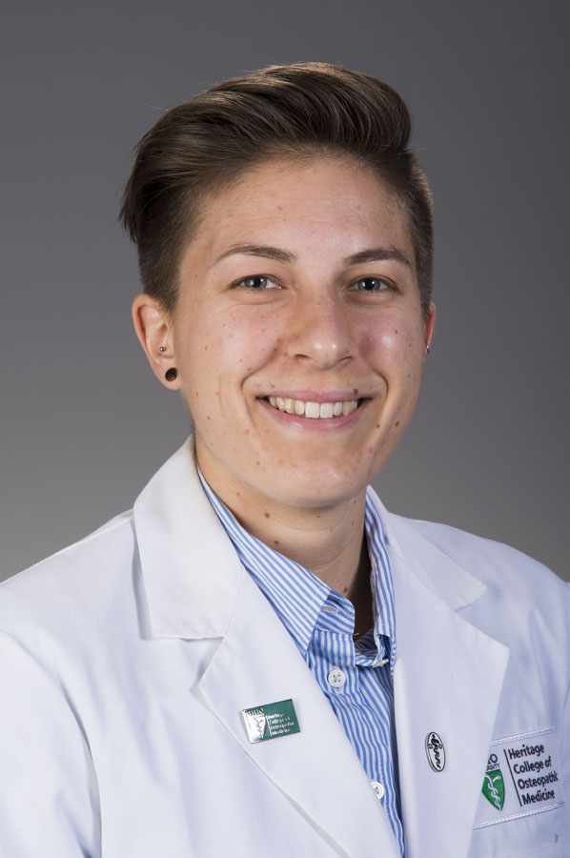
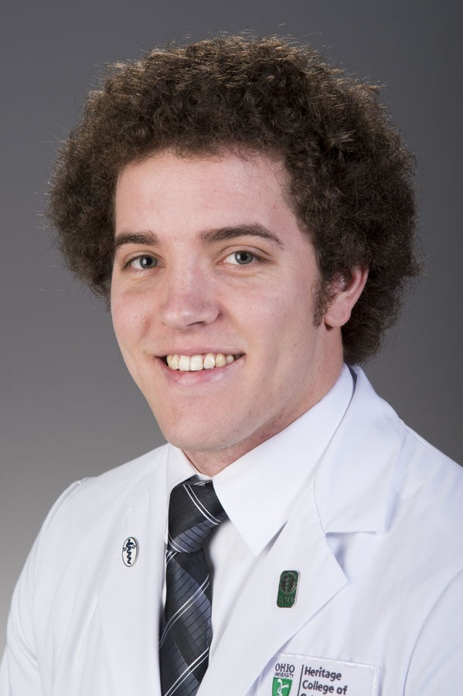
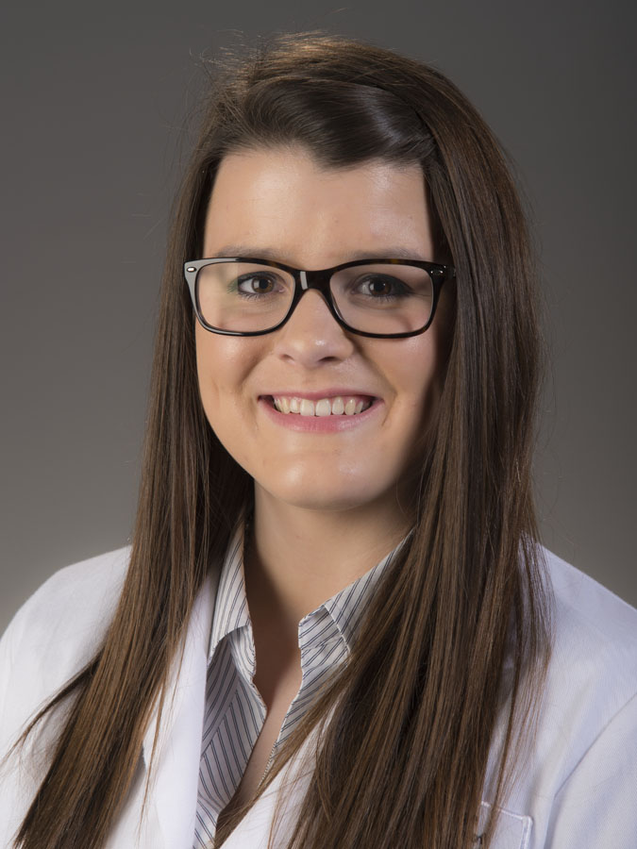
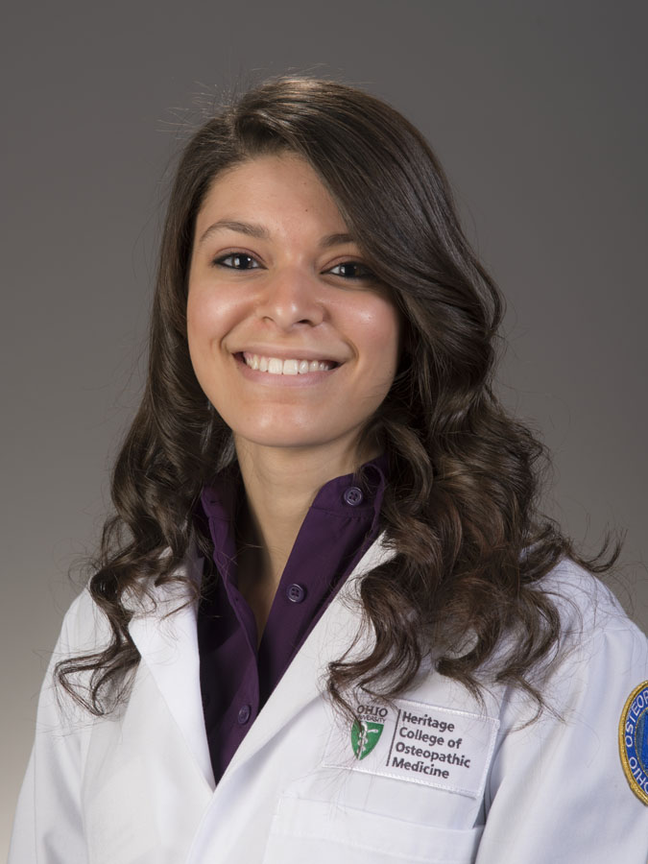
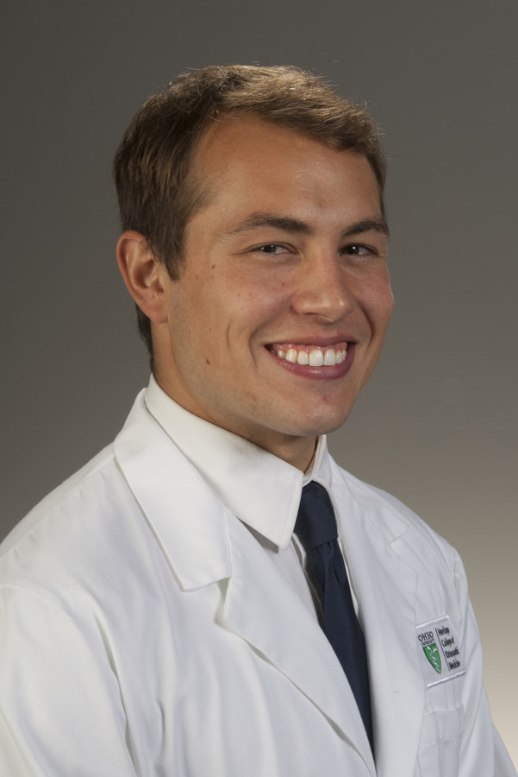
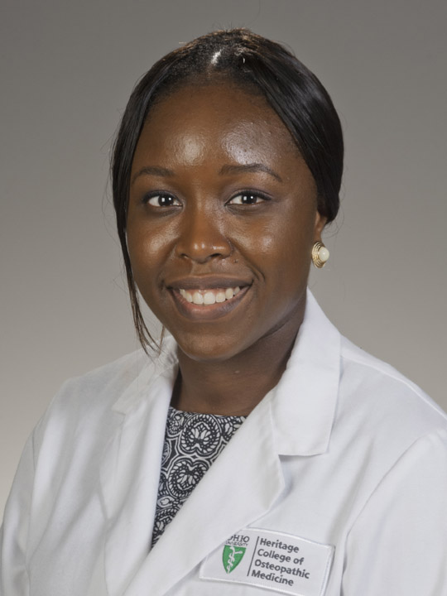
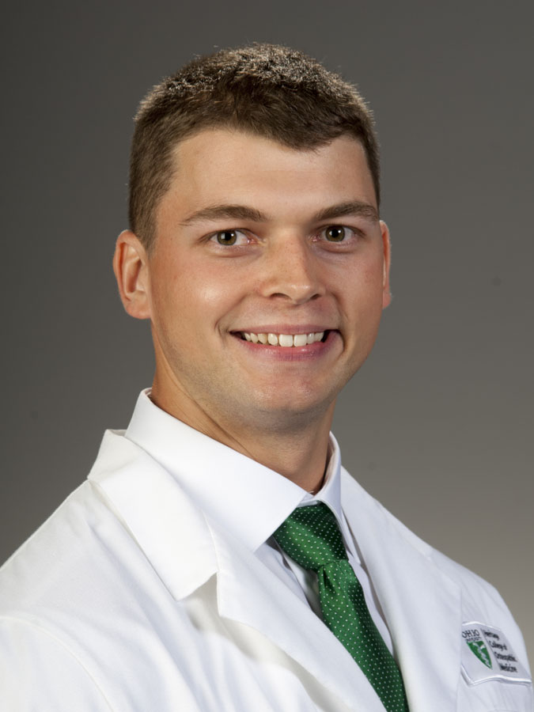
Anatomy of the Immersion: staff
Michelle Hoffman
MSIV, DFM Assoc.
Seth Sigler
MSIV, OMM Fellow
HCOM – Athens
Chelsea Bitler
OMSII
HCOM TA
Kristen Cuevas
OMSII
HCOM TA
Vincent Martello
OMSII
HCOM TA
Keisha Pierre-Lys
OMSII
HCOM TA
Zachary Thomas
OMSII
HCOM TA

Slide 10
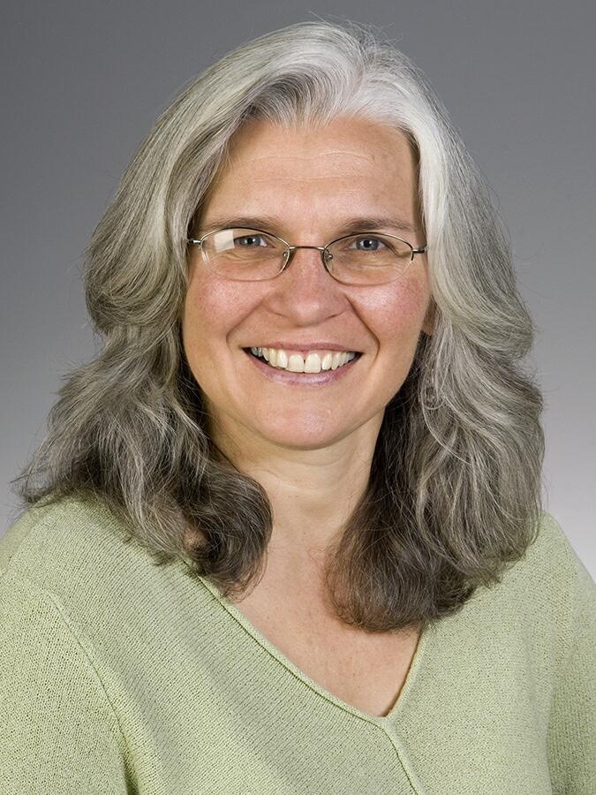
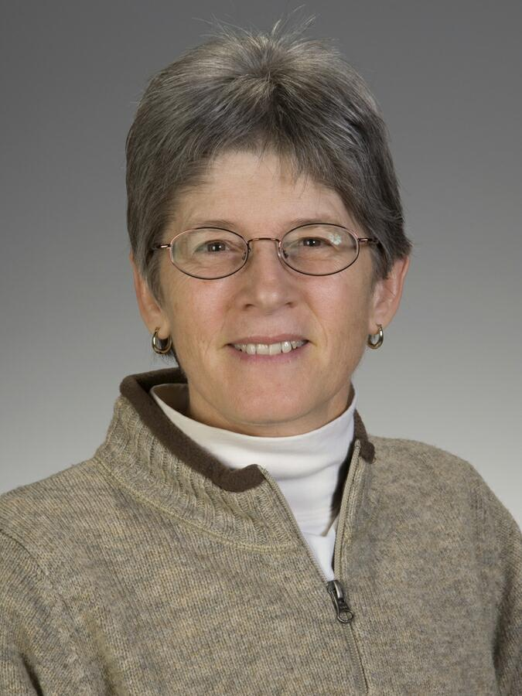
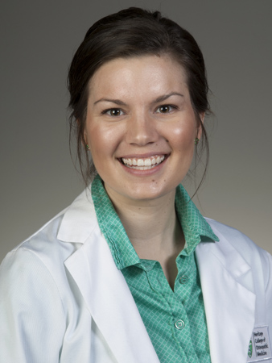
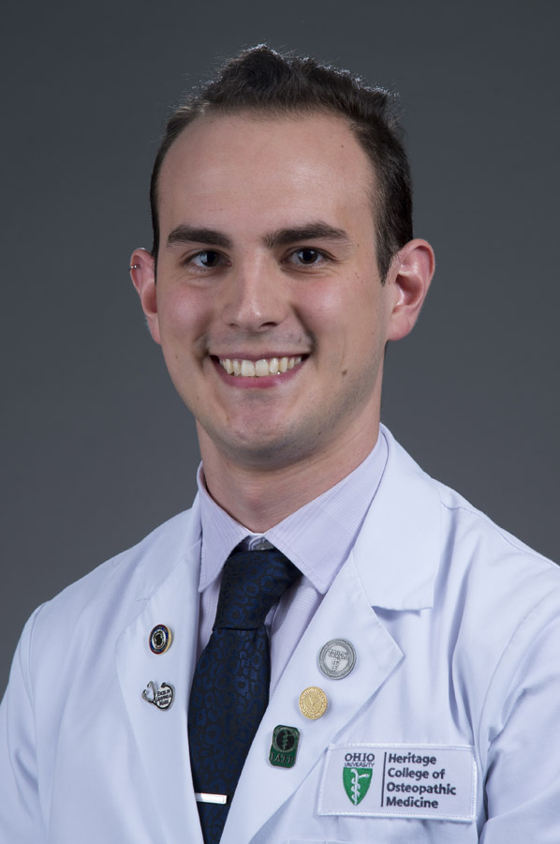
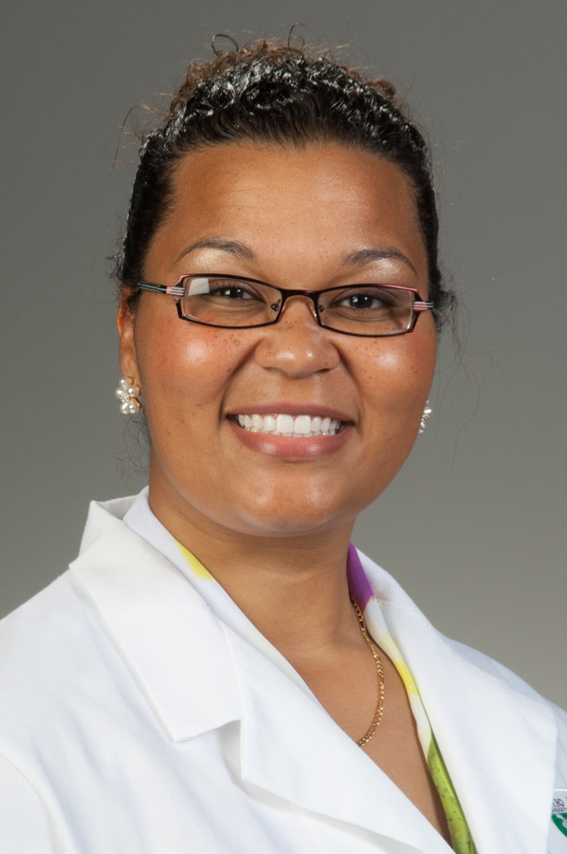
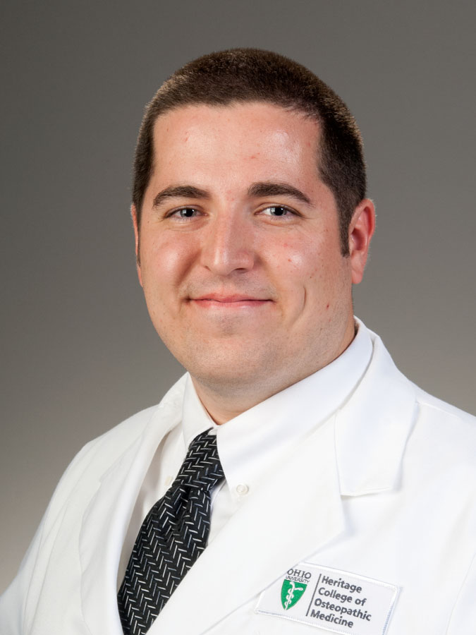
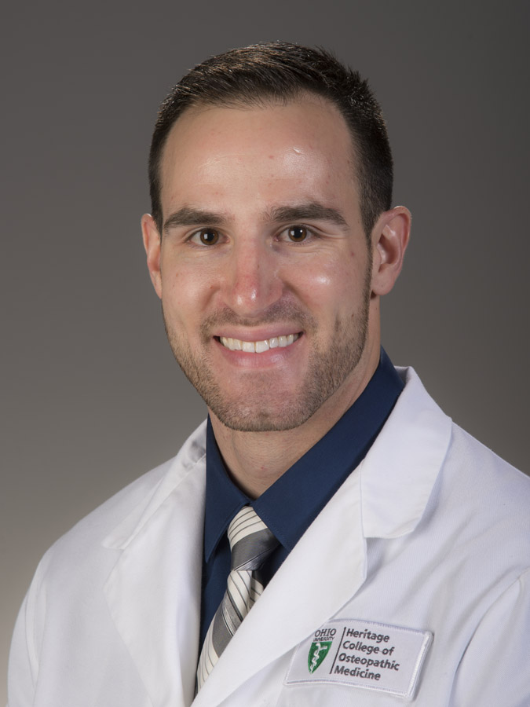
Anatomy of the Immersion: staff
A. Biknevicius, PhD
Associate Professor
R. Code, PhD
Associate Professor
Allyson Halderman MSIV
OMM/DFM Associate
Nate Kralik MSIV
OMM/DFM Associate
HCOM – Dublin
Jessica Motley
OMSII
HCOM TA
Jacob O’Day
OMSII
HCOM TA
Zach Werner
OMSII
HCOM TA

Slide 11
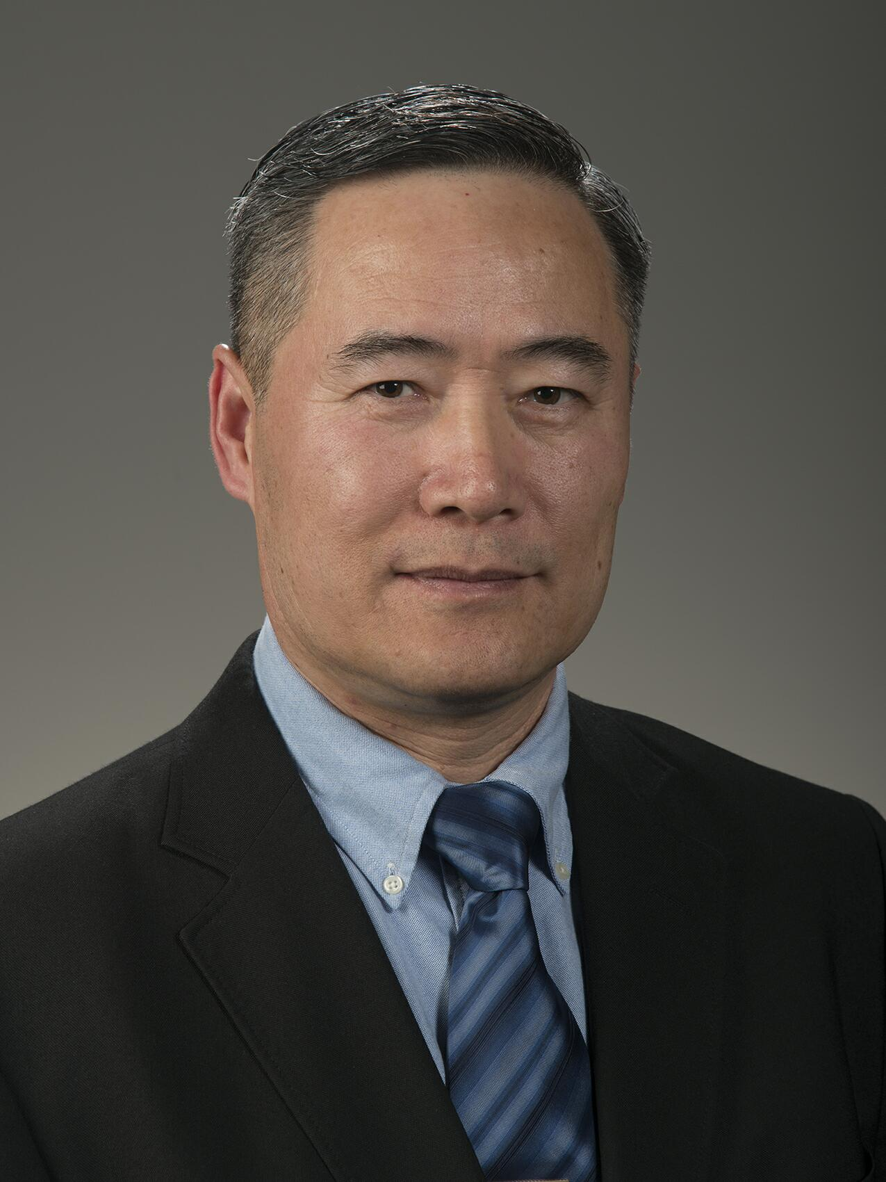
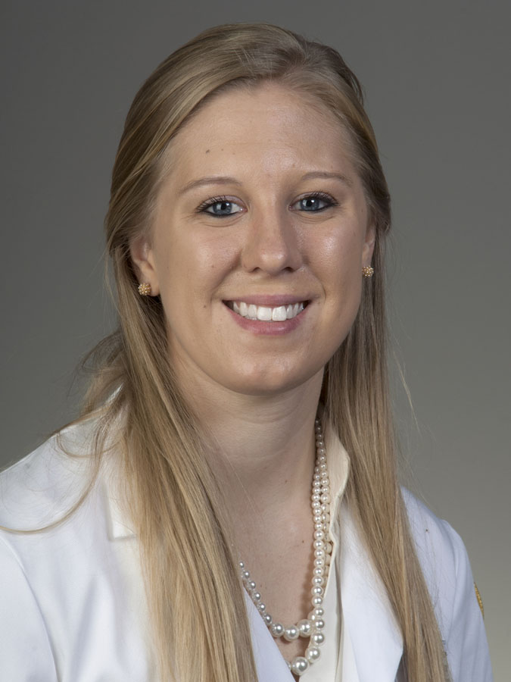
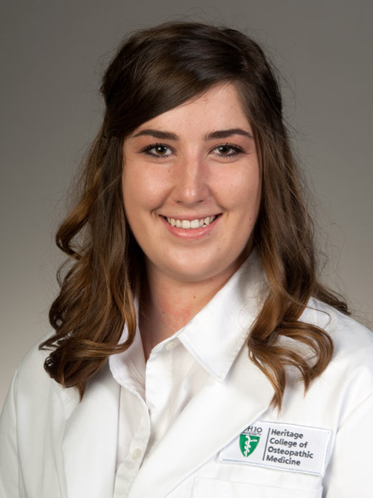
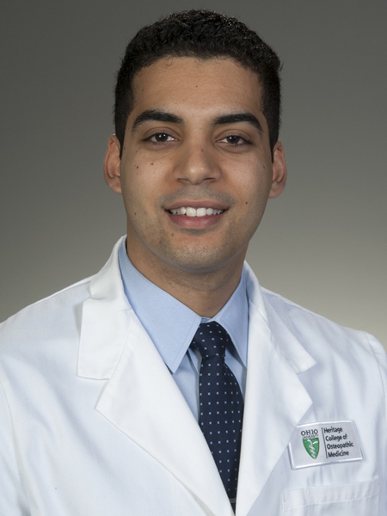
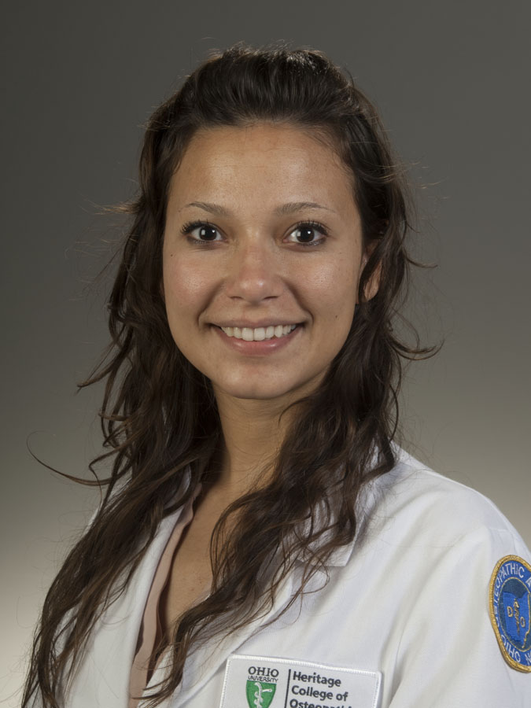
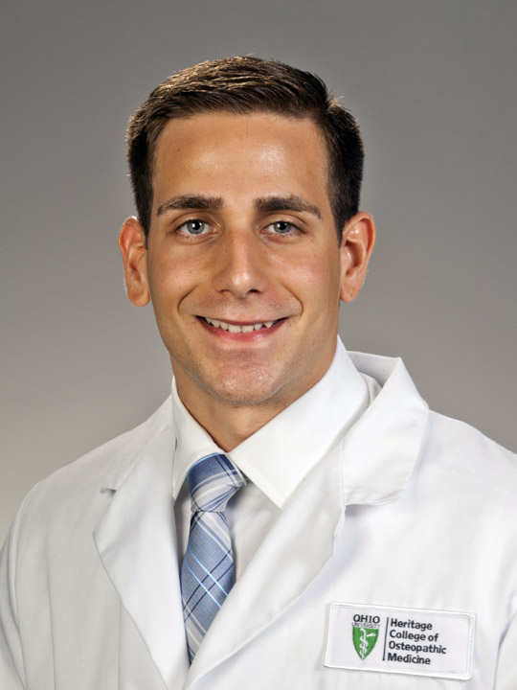
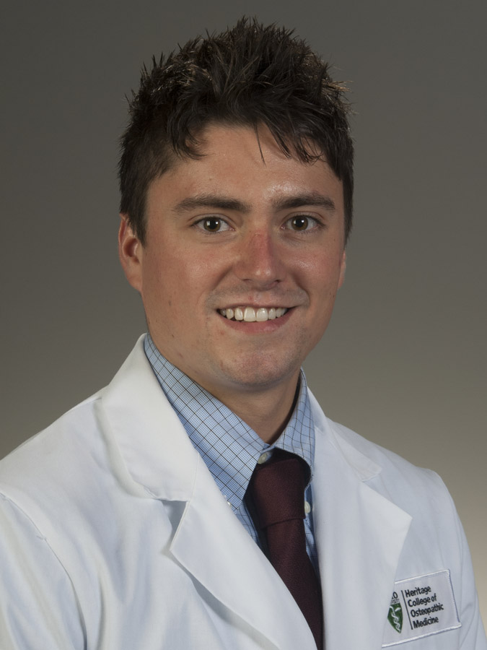
Anatomy of the Immersion: staff
J. O’Reilly, PhD
Instructor
Wei-Ming Duan, MD, PhD
Instructor
Samantha DeMarsh
OMM/DFM Associate
Danielle Thornsberry
OMM/ DFM Associate
HCOM – Cleveland
Daniel Caicedo
OMSII
HCOM TA
Renate Gyenge
OMSII
HCOM TA
Nikitas Maglis
OMSII
HCOM TA
Mike Vanes
OMSII
HCOM TA

Slide 12
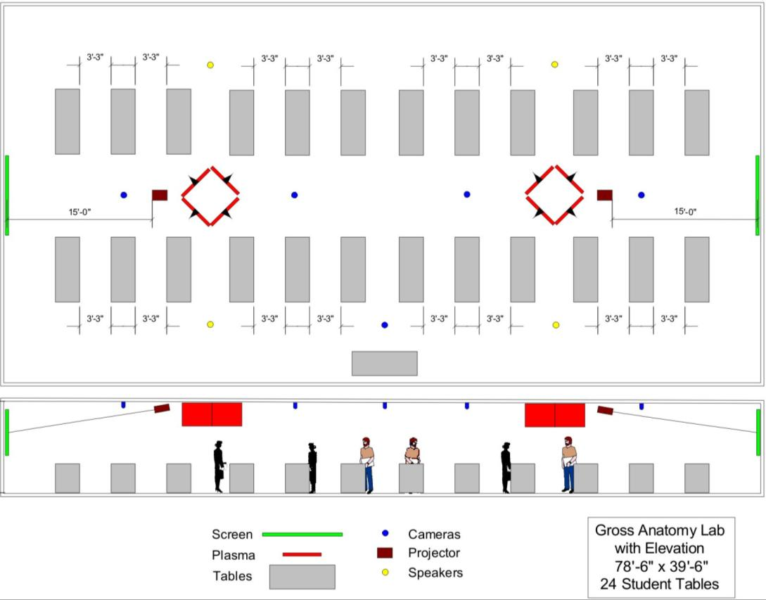
Anatomy of the Immersion: The Lab
• 4 or 5 students/table
• Athens: Sections A & B, alternate AM/PM slot weekly
• Teams do their own dissections. Division of labor: cutters, readers, …
• Dissect BOTH sides of the donor
• Come to lab at off times to finish up
• Attendance in lab is mandatory
A
B
A
B
A
B
A
B
A
B
A
B
B
A
B
A
B
A
B
A
B
A
B
A

Slide 13
Anatomy of the Immersion: The Lab
Mandatory Attendance
Why?
• Material is central to your training
• Responsibility to your dissecting team
• Honoring the gift of a donated body
Stay for the whole lab
• Work on dissection
• If dissection is completed, work with other resources
(e.g., other donors, bones, imaging, etc.)

Slide 14
Anatomy of the Immersion: Imaging
Medical Imaging Basics in Mediasite
Dr. Jeffery S. Benseler, DO
• online video modules
• online self-study PowerPoints
• Face-to-face session Aug 15th
Medical Imaging Basics
• four asynchronous learning modules in Mediasite
• linked on Blackboard under “Imaging Resources”
• provide foundations of different imaging modalities
• won’t be assessed on the details but view well before Aug 15th session
Online Self-study PowerPoints
• linked on Blackboard under “Imaging Resources”
• required content on which you will be assessed according to these dates
• Lumbar Spine Imaging: Exam 1 – Monday, July 31st
• Cervical Spine Imaging: Exam 1 – Monday, July 31st
• Upper Extremity Imaging: Exam 2 – Monday, August 14th
• Lower Extremity Imaging: Exam 3 – Friday, August 25th

Slide 15
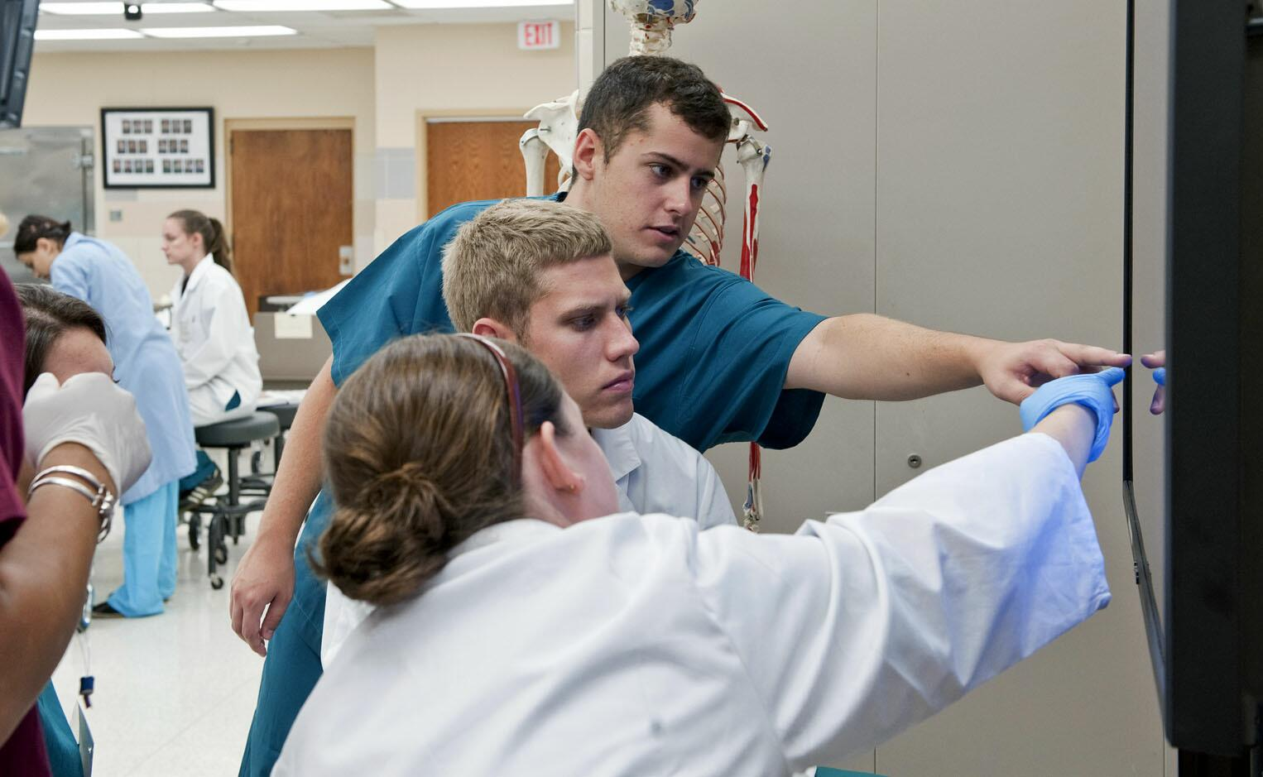
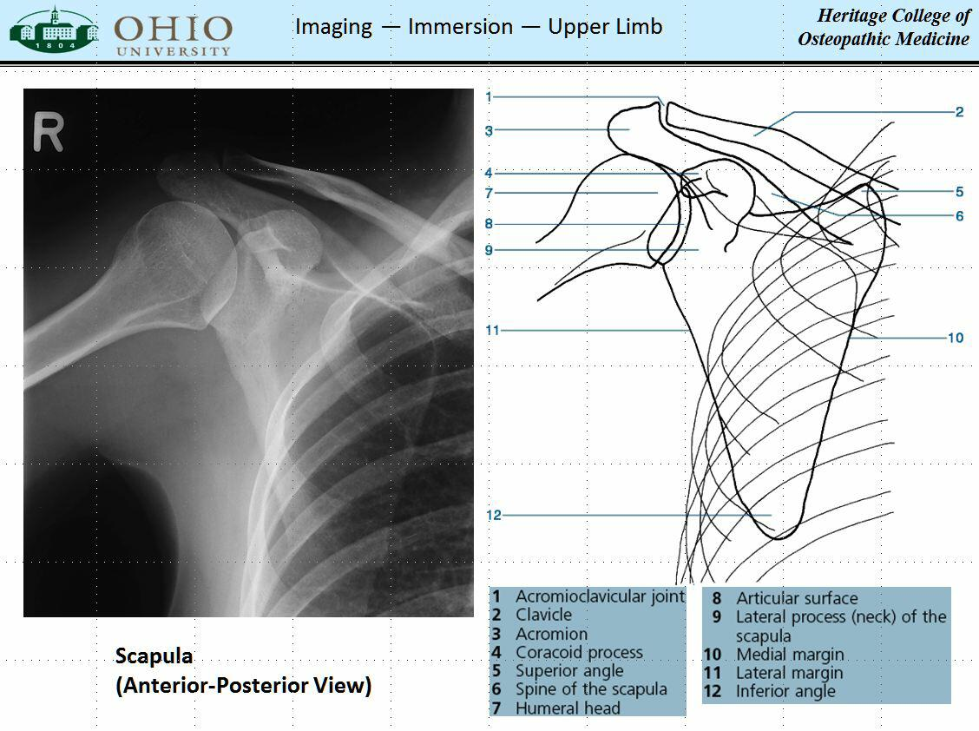
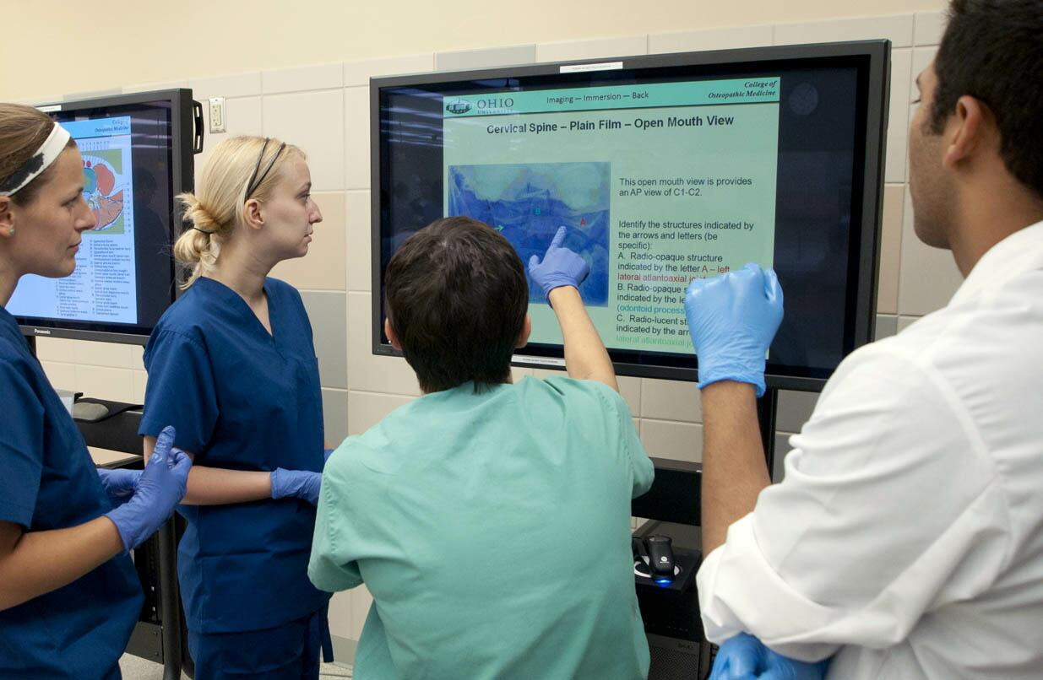
Anatomy of the Immersion: Imaging Stations
• Plain, CT, MRI
• Importance of sectional anatomy for imaging
• Very detailed but provide key correlations
• Use Dr. Benseler’s PPTs as guide for exam prep
• PDFs on Blackboard but not for distribution

Slide 16
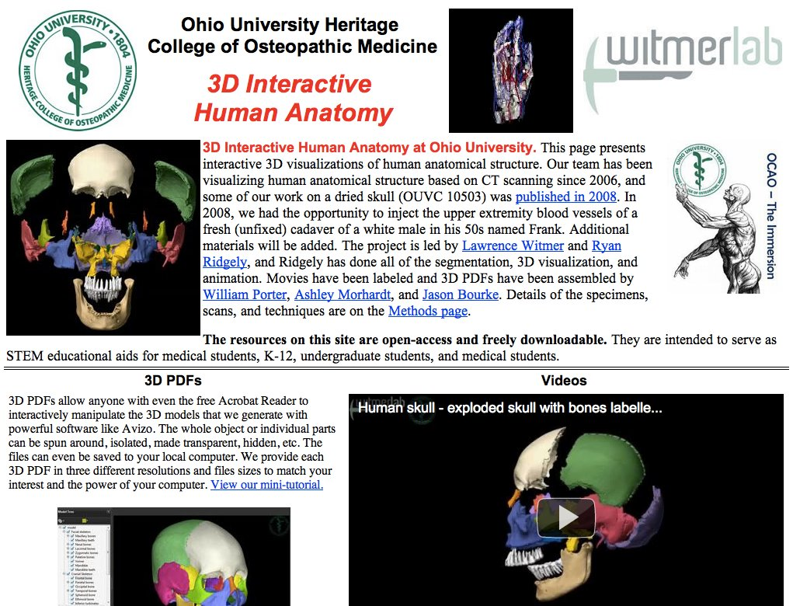
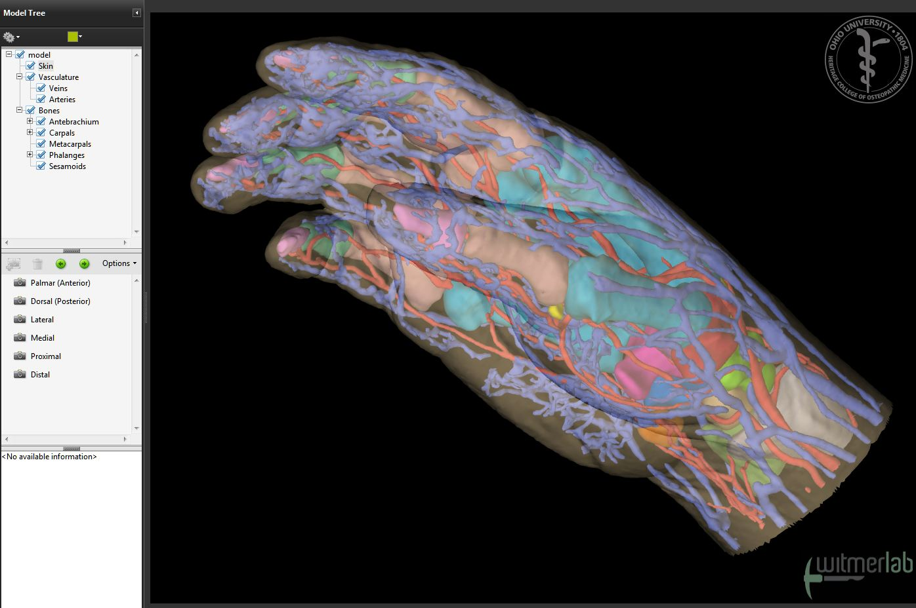
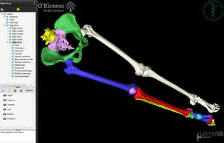
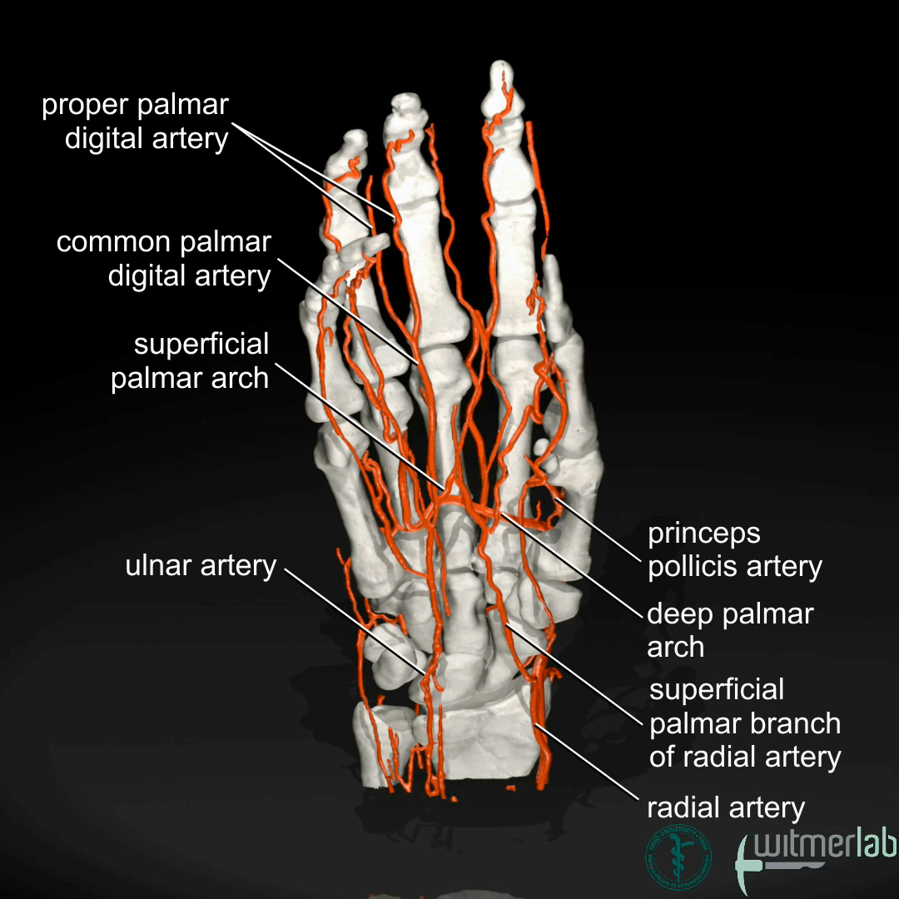
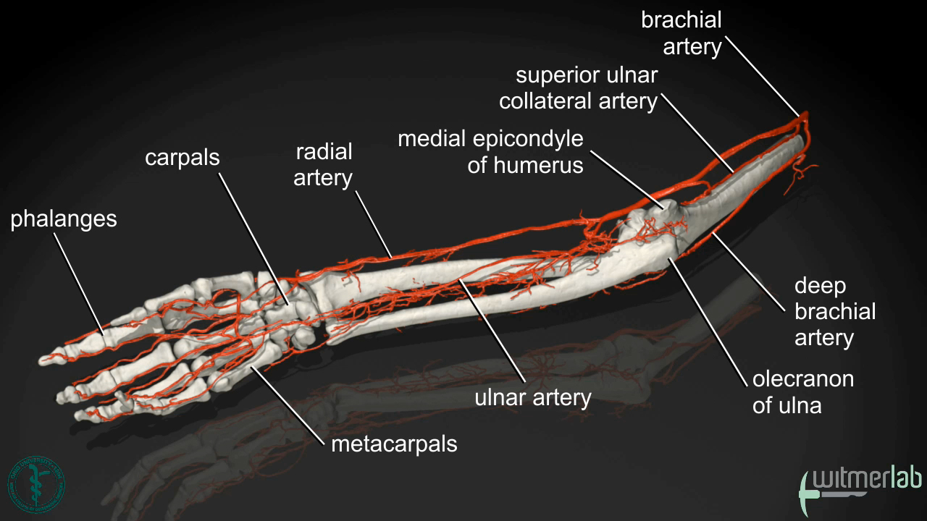
Anatomy of the Immersion: Online
http://www.ohio.edu/people/witmerl/3D_human.htm
3D PDFs
movies

Slide 17
Anatomy of the Immersion:
Clinical Themes & Question of the Day
Clinical Themes
• Posted at the beginning of lab
• Provide clinical correlations
• For your reference; instructors may or may not discuss
• Available online prior to lab
A
A
A
A
A
A
A
A
A
A
A
A
Question of the Day (QOD)
• Short clinical vignette
• Table team explores the QOD
• Faculty & Fellow/Associates will discuss QOD with trios or pairs of tables
A
A
Faculty
Fellow/Associate

Slide 18
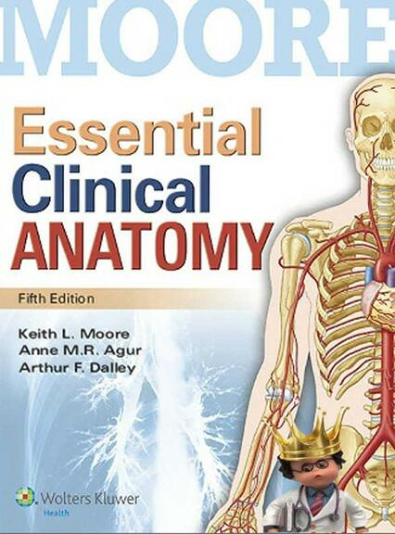
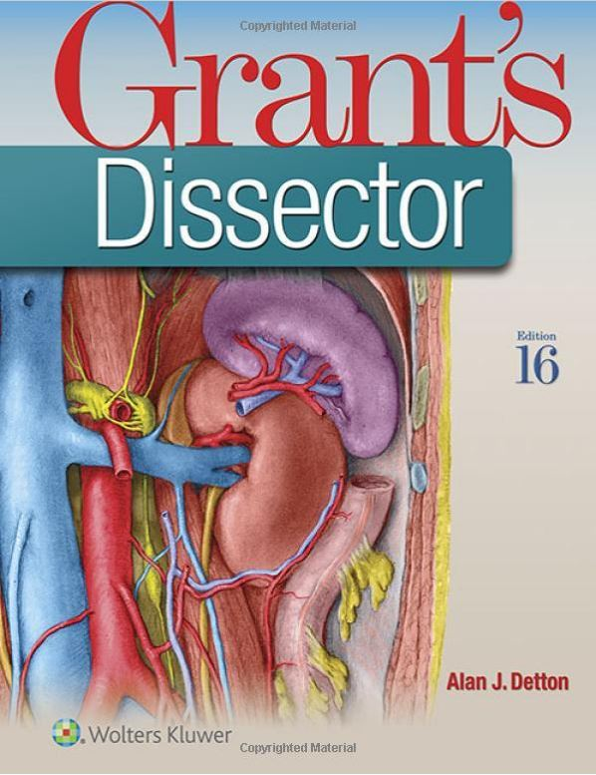
Anatomy of the Immersion: Books
• Relevant pages to read are on the schedule.
• Moore’s Clinical “Blue Boxes” are key (but you won’t understand them without reading what’s between!)
• Dissector & Atlas must be at each table!
• Read dissector prior to coming to lab
• iPad and Kindle version of books are fine
• Anatomy.tv by Primal Pictures (click image below)

Slide 19
Anatomy of the Immersion: Assessment
1. Four self-assessment quizzes online on Blackboard
2. Three sets of written (ExamSoft e-tests) and practical exams
1. Monday, July 31st – Back
2. Monday, August 14th – Upper Extremity
3. Friday, August 25th – Lower Extremity
3. Year-2 med student assistants will be setting up mock practicals

Slide 20
Donors & Body Donation
• Role of the donor: 3D anatomy, variation, “diagnosis” of pathology, etc.
• Significance of the donor
• A profound experience
• Directly see & handle structures you’ll later have to imagine
• Opportunity and privilege to work on an actual human
• Potentially uncomfortable feelings
• Death: Illness, end-of-life, dying, corporeal remains
• A very different kind of intimacy
• Overcoming societal taboos
• Sadness: clear evidence of their humanity
• Body donation
• Conscious, often family decision to donate
• The ultimate gift
• Honoring that gift
• Respect, professionalism
• USE the gift: prepare for lab, don’t miss lab,
study & learn from all the donors
• Great book! — Body of Work, by C. Montross, MD

