Slide 1
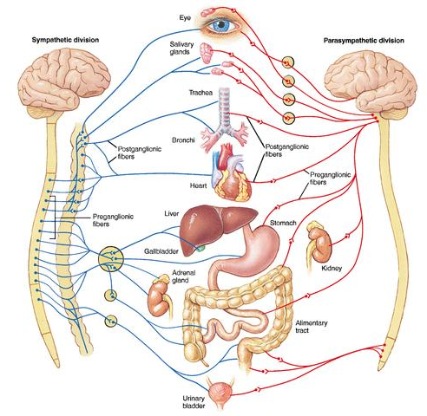
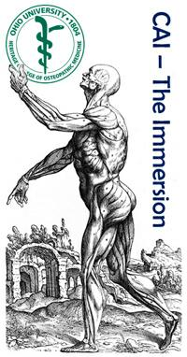
Peripheral Nervous System 2:
The Autonomic System
7 August 2017
Reading: Moore’s ECA5 33–39
ECA4 36–43
Lawrence M. Witmer, PhD
Professor of Anatomy
Dept. of Biomedical Sciences
Heritage College of Osteopathic Medicine, Ohio University
Athens, Ohio 45701
witmerL@ohio.edu

Slide 2
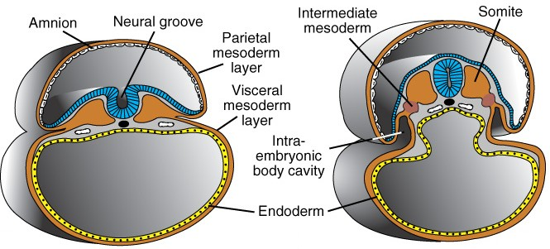
Somatic vs. Visceral
attribute | Somatic System | Visceral System
embryological origin of tissue | “body wall:” somatic (parietal) mesoderm (dermatome, myotome) | “organs:” splanchnic (visceral) mesoderm, endoderm
examples of adult tissues | dermis of skin, skeletal muscles, connective tissues | glands, cardiac muscle, smooth muscle
perception | conscious, voluntary | unconscious, involuntary
Langman’s Embryo 9 2004

Slide 3
Sensory/Motor + Somatic/Visceral
 | Somatic | Visceral
Sensory (Afferent) | somatic sensory [General Somatic Afferent (GSA)] | visceral sensory [General Visceral Afferent (GVA)]
Motor (Efferent) | somatic motor [General Somatic Efferent (GSE)] | visceral motor [General Visceral Efferent (GVE)]
Somatic
Nervous
System
Autonomic
Nervous
System
(July 24)
(today)

Slide 4
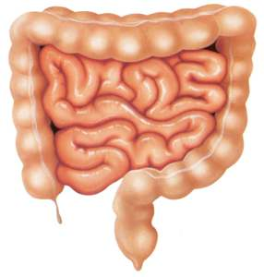
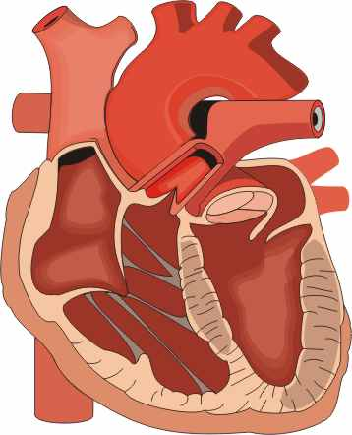
Overview of the Autonomic Nervous System
Similarities between Sympathetic & Parasympathetic
• Both are efferent (motor) systems: “visceromotor”
• Both involve regulation of the “internal” environment generally outside of our conscious control: “autonomous”
• Both involve 2 neurons that synapse in a peripheral ganglion
• Innervate glands, smooth muscle, cardiac muscle
glands
CNS
ganglion
smooth
muscle
cardiac
muscle
preganglionic
neuron
postganglionic
neuron

Slide 5
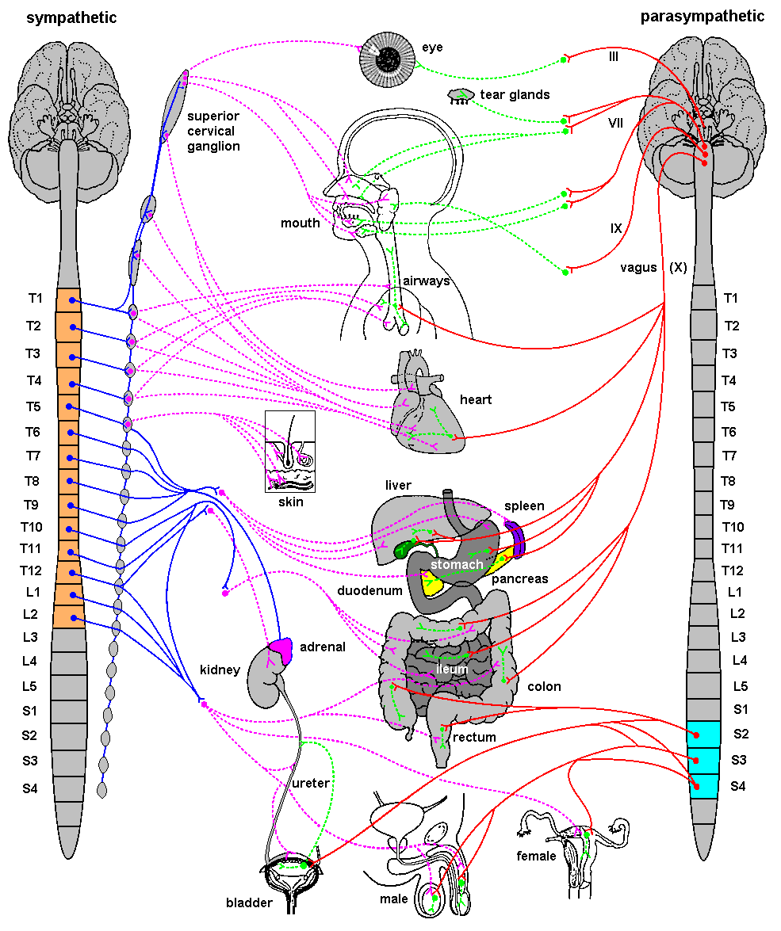
Overview of the Autonomic Nervous System
Differences between Sympathetic & Parasympathetic
Location of Preganglionic Cell Bodies
Sympathetic
Parasympathetic
Thoracolumbar
T1 – L2/L3 levels of the spinal cord
Craniosacral
Brain: CN III, VII, IX, X
Spinal cord: S2 – S4

Slide 6
Overview of the Autonomic Nervous System
Differences between Sympathetic & Parasympathetic
Relative Lengths of Neurons
Sympathetic
CNS
ganglion
target
short preganglionic
neuron
long postganglionic
neuron
Parasympathetic
ganglion
target
CNS
long preganglionic
neuron
short postganglionic
neuron

Slide 7
Overview of the Autonomic Nervous System
Differences between Sympathetic & Parasympathetic
Neurotransmitters
Sympathetic
NE (ACh at sweat glands),
+ / -, α & ß receptors
ACh, +
• All preganglionics release acetylcholine (ACh) & are excitatory (+)
• Symp. postgangl. — norepinephrine (NE) & are excitatory (+) or inhibitory (-)
• Parasymp. postgangl. — ACh & are excitatory (+) or inhibitory (-)
• Excitation or inhibition is a receptor-dependent & receptor-mediated response
Parasympathetic
ACh, +
Potential for pharmacologic
modulation of autonomic responses
ACh, + / -
muscarinic receptors

Slide 8
Overview of the Autonomic Nervous System
Differences between Sympathetic & Parasympathetic
Target Tissues
Sympathetic
Parasympathetic
• Organs of head, neck, trunk, & external genitalia
• Organs of head, neck, trunk, & external genitalia
• Adrenal medulla
• Sweat glands in skin
• Arrector muscles of hair
• ALL vascular smooth muscle
» Sympathetic system is distributed to essentially all tissues (because of vascular smooth muscle)
» Parasympathetic system never reaches limbs or body wall (except for external genitalia)

Slide 9
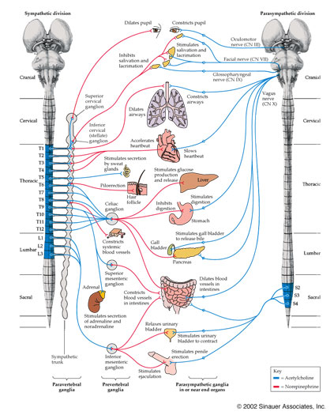
Overview of ANS
Functional Differences
Sympathetic
• “Fight or flight”
• Catabolic (expend energy)
Parasympathetic
• “Feed & breed”, “rest & digest”
• Homeostasis
» Dual innervation of many organs — having a brake and an accelerator provides more control

Slide 10
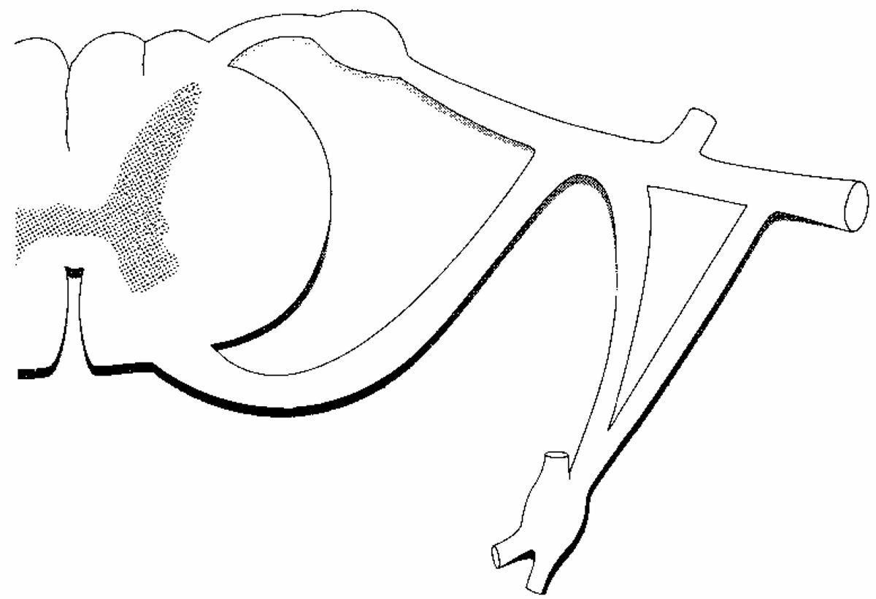
Structure of spinal nerves: Somatic pathways
dorsal root
ganglion
dorsal
ramus
dorsal root
spinal
nerve
somatic
sensory
nerve
(GSA)
dorsal
horn
CNS
inter-
neuron
ventral
horn
somatic
motor
nerve
(GSE)
ventral
ramus
gray ramus
communicans
ventral root
white ramus
communicans
Mixed Spinal
Nerve
sympathetic
ganglion

Slide 11
Structure of spinal nerves: Sympathetic pathways
dorsal
ramus
intermediolateral
gray column
spinal
nerve
ventral
ramus
gray ramus
communicans
white ramus
communicans
sympathetic
ganglion

Slide 12
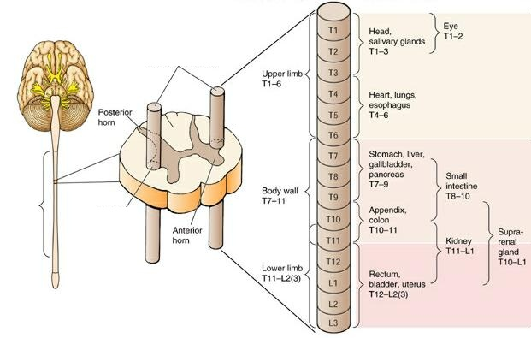
Sympathetic System: Preganglionic Cell Bodies
• Preganglionic cell bodies in
intermediolateral gray
• T1 – L2/L3
• Somatotopic organization
somatic tissues
(body wall, limbs)
visceral tissues
(organs)
intermediolateral
gray columns
T1 –
L2/L3
lateral
horn
Clinical Relevance
» dysfunction due to cord injury
» spinal nerve impingement & OMM
» referred pain
Moore’s COA6 2010

Slide 13
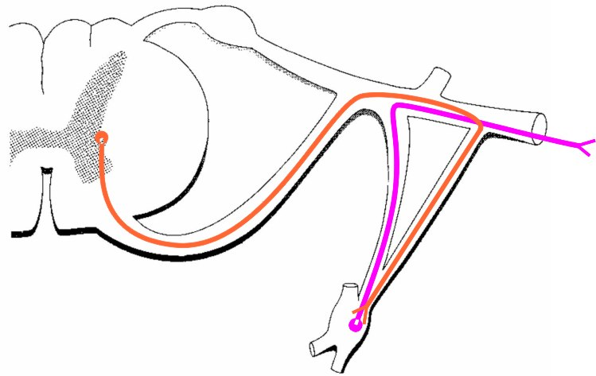
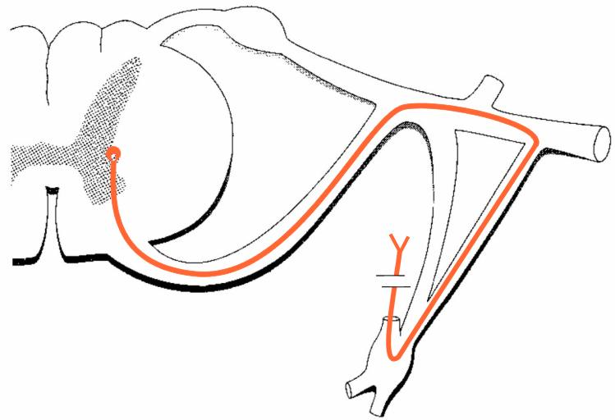
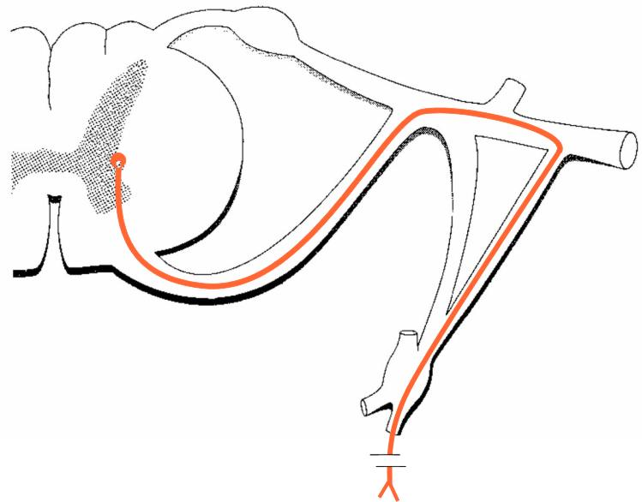
Sympathetic System: Postganglionic Cell Bodies
1. Paravertebral ganglia
• Located along sides of vertebrae
• United by preganglionics into Sympathetic Trunk
• Preganglionic neurons are thoracolumbar (T1–L2/L3) but postganglionic neurons are cervical to coccyx
• Some preganglionics ascend or descend in trunk
Paravertebral
ganglia
sympathetic
trunk (chain)
synapse at
same level
Prevertebral ganglia
• celiac ganglion
• sup. mesent. g.
• inf. mesent. g.
ascend to
synapse at
higher level
descend to
synapse at
lower level
aorta
Moore’s COA6 2010

Slide 14
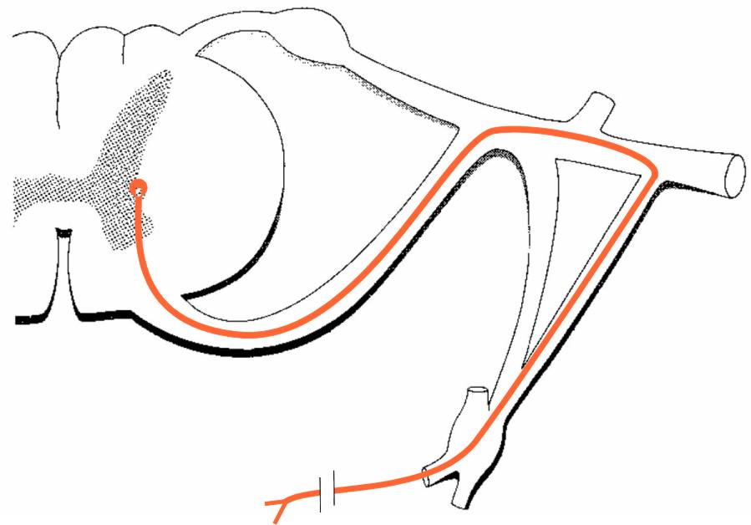
Sympathetic System: Postganglionic Cell Bodies
2. Prevertebral (preaortic) ganglia
• Located anterior to abdominal aorta, in plexuses surrounding its major branches
• Preganglionics reach prevertebral ganglia via abdominopelvic splanchnic nerves
Paravertebral
ganglia
sympathetic
trunk (chain)
Prevertebral ganglia
• celiac ganglion
• sup. mesent. g.
• inf. mesent. g.
abdominopelvic
splanchnic
nerve
aorta
Moore’s COA6 2010

Slide 15
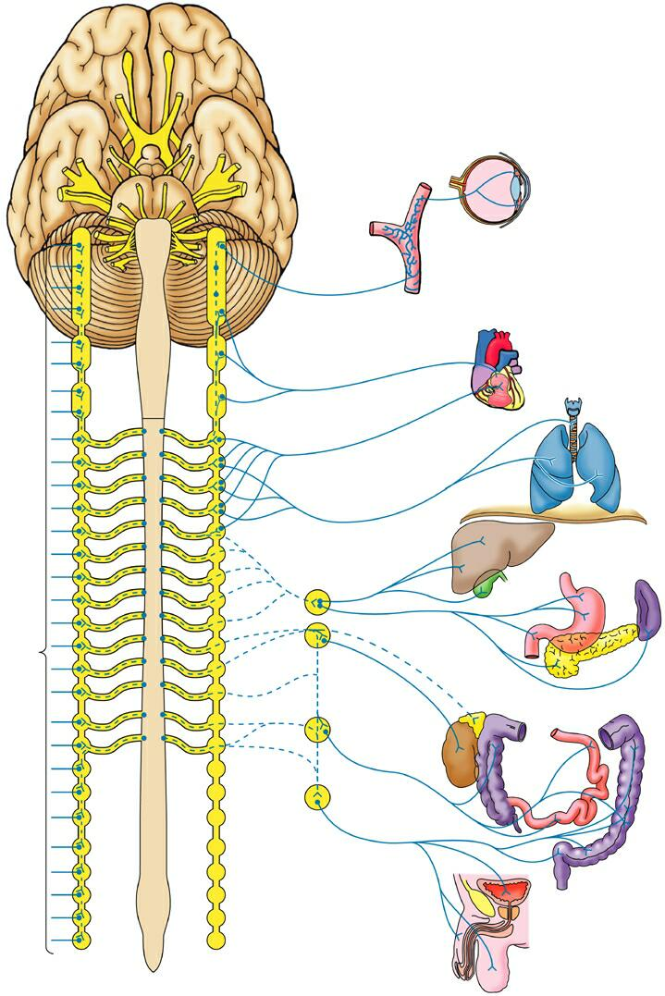
Sympathetic System: Summary
visceral tissues
(organs)
somatic tissues
(body wall, limbs)
Cardiopulmonary Splanchnics: postganglionic fibers to thoracic viscera
T1
postganglionics
via 31 spinal nerves
to somatic tissues of neck, body wall, and limbs
Abdominopelvic Splanchnics: preganglionic fibers to prevertebral ganglia, postganglionic fibers to abdominopelvic viscera
sympathetic
trunk
L2
prevertebral
ganglia
Moore’s COA6 2010

Slide 16
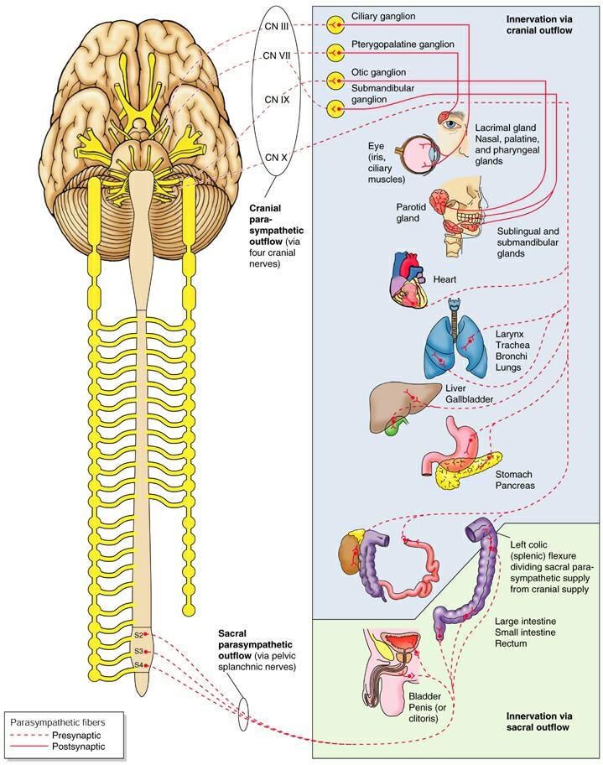
Parasympathetic
Pathways
Cranial outflow
• CN III, VII, IX, X
• Four ganglia in head
• Vagus nerve (CN X) is major preganglionic parasymp. supply to thorax & abdomen
• Synapse in ganglia within wall of the target organs (e.g., enteric plexus of GI tract)
Sacral outflow
• S2–S4 via pelvic splanchnics
• Hindgut, pelvic viscera, and external genitalia
Clinical Relevance
» Surgery for colorectal cancer puts pelvic splanchnics at risk
» Damage causes bladder & sexual dysfunction
Moore’s COA6 2010

Slide 17
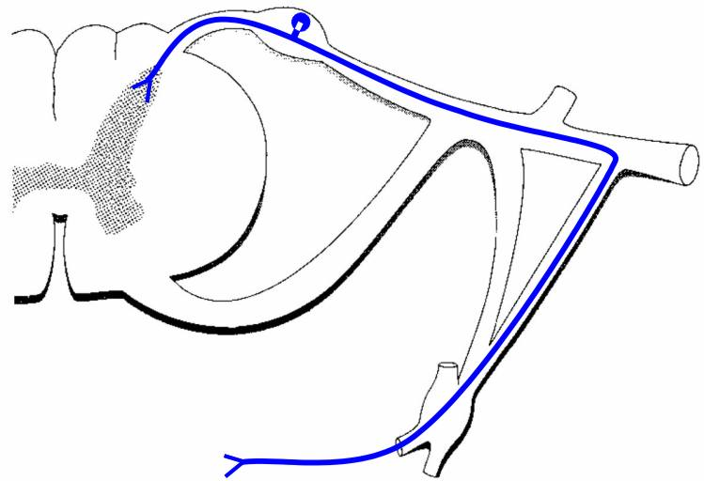
Visceral Afferents and Referred Pain
dorsal root ganglion
Visceral sensory nerves [GVA]
• run with sympathetic & parasympathetic nerves
• cell bodies in dorsal root ganglion
• nerve ending in viscera
Somatic sensation:
• conscious, sharp, well-localized
• touch, pain, temperature, pressure, proprioception
Visceral sensation:
• often unconscious; if conscious: dull, poorly-localized
• distension, blood gas, blood pressure, cramping, irritants

Slide 18
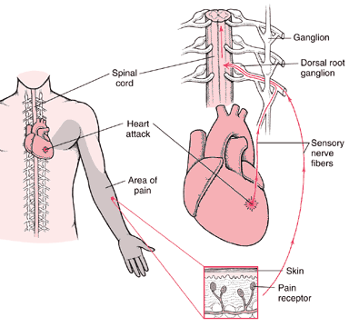
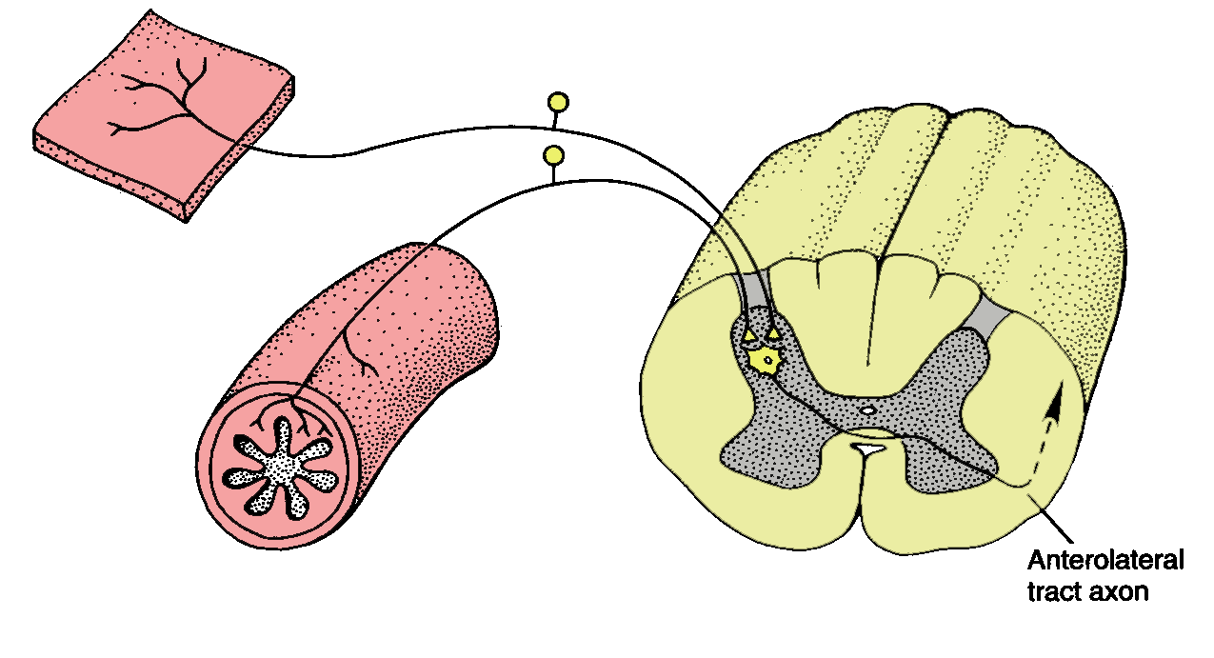
Visceral Afferents and Referred Pain
Referred Pain:
• Pain originating in a visceral structure perceived as being from an area of skin innervated by the same segmental level as the visceral afferent
• Results from convergence of somatic & visceral afferents on the same segmental level of the spinal cord
• “Cross-talk” in the dorsal horn
convergence &
“cross-talk”
somatic afferent
www.merck.com
visceral afferent
Kandel et al. 2000

Slide 19
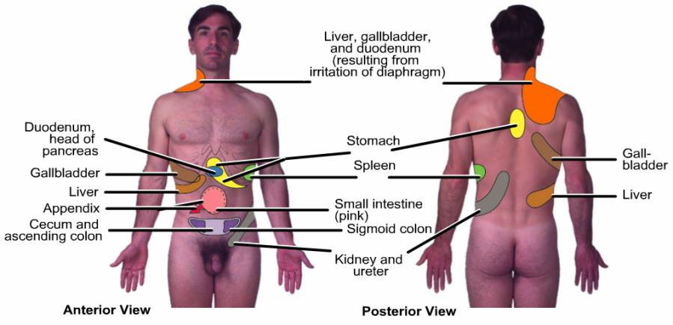
Visceral Afferents and Referred Pain
Maps of Referred Pain
Grant’s Atlas 12 2009

Slide 20
References
Agur, A. M. R. and A. F. Dalley. 2009. Grant’s Atlas of Anatomy, 12th Edition. Lippincott, Williams & Wilkins, New York.
Kandel, E. R., J. H. Schwartz, and T. M. Jessell. 2000. Principles of Neural Science, 4th Edition. McGraw-Hill, New York.
Moore, K. L., A. F. Dalley and A. M. E. Agur. 2010. Clinically Oriented Anatomy, 6th Edition. Lippincott, Williams & Wilkins, New York.
Sadler, T. W. 2004. Langman’s Medical Embryology, 9th Edition. Lippincott, Williams & Wilkins, New York.

